Slide 1
Where we are and where we are going

Slide 2
Where we are and where we are going
Dead Reckoning
Mobile Robot
Localisation
Point to point navigation
Reactive Navigation
Map-based Localisation

Slide 3
Today lecture
Map-based localisation
Bayes filter (theoretical idea)
Kalman filter (practical implementation)
Case study: Map-based localisation using Kalman filter (Worked examples)

Slide 4
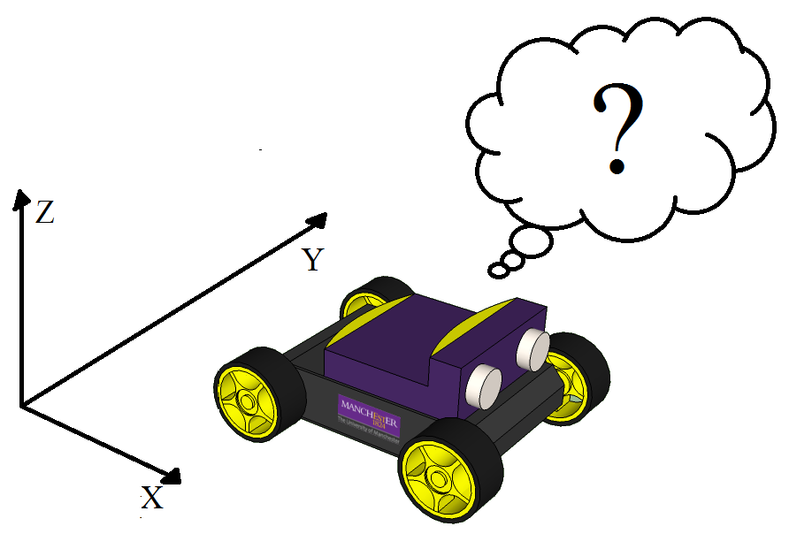
Localisation
The robot needs to know its location in the environment in order to make proper decisions.
Localisation can be achieved using:
Proprioceptive sensors (encoders, IMU). This type of localisation is named dead reckoning localisation.
Exteroceptive sensors (sonar, LiDAR, camera). This type of localisation is named map-based localisation.
External sensors (GPS). Not suitable for indoor applications.

Slide 5
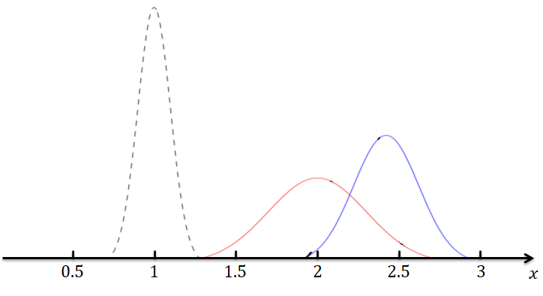


















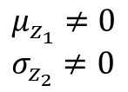






















Kalman filter - example
$$m_{1}$$
$$z_{k}$$
$$0.5$$
$$1$$
$$1.5$$
$$2$$
$$2.5$$
$$3$$
$$x$$
$$μ_{0}=0 \\ σ_{0}=0$$
$$μ_{1}≠0 \\ σ_{1}≠0$$
$$μ_{2}≠0 \\ σ_{2}≠0$$
$$μ_{z_{1}}≠0 \\ σ_{z_{2}}≠0$$
$$0.5$$
$$1$$
$$1.5$$
$$2$$
$$2.5$$
$$3$$
$$0.5$$
$$1$$
$$1.5$$
$$2$$
$$2.5$$
$$3$$
$$0.5$$
$$1$$
$$1.5$$
$$2$$
$$2.5$$
$$3$$
$$0.5$$
$$1$$
$$1.5$$
$$2$$
$$2.5$$
$$3$$
$$x$$
$$x$$
$$x$$
$$x$$

Slide 6
Bayes Filter
A Geometric Approach

Slide 7
Bayes filter – theoretical foundation
The goal of this presentation is to provide an understanding of map-based localization through a geometric perspective, rather than focusing on mathematical formalism.

Slide 8


Bayes filter – theoretical foundation
Bayes filter is a probabilistic approach to recursively estimates some unknown PDFs as new information, such as measurements, becomes available, i.e., combining several sources of information.
1. State transition, or motion model probability:
$$p\left(s_{k} | s_{k−1},u_{k−1}\right)$$
2. Measurement, or observation model probability:
$$p\left(z_{k} | s_{k}\right)$$

Slide 9
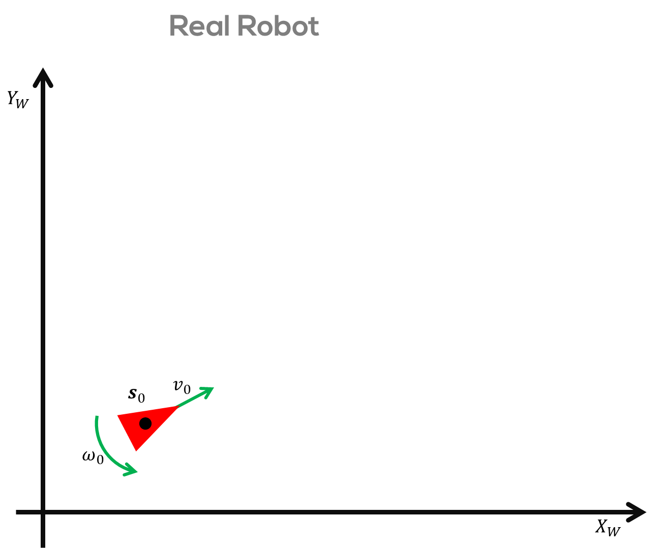
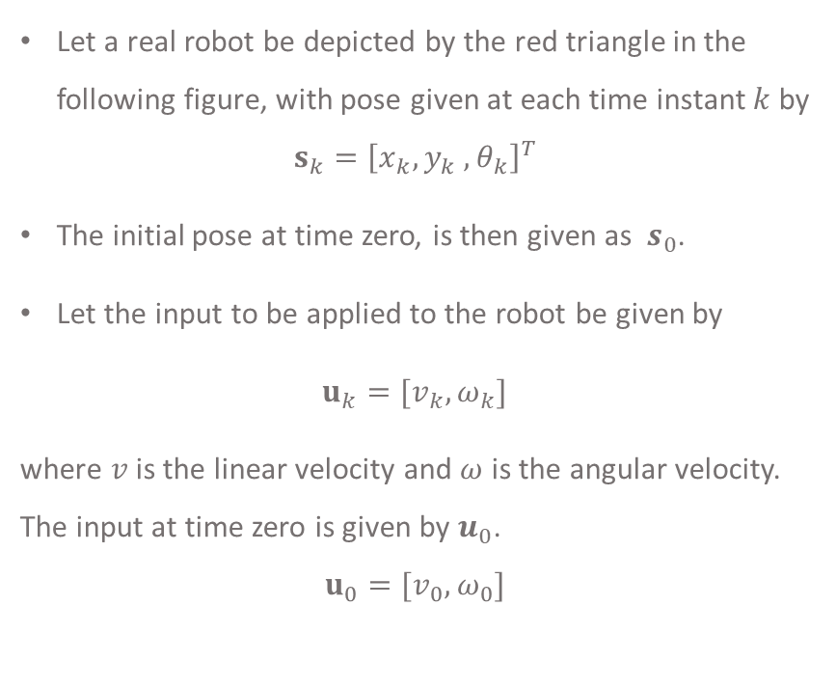
Real Robot
Let a real robot be depicted by the red triangle in the following figure, with pose given at each time instant $k$ by
$$s_{k}={\left[x_{k},y_{k} ,θ_{k}\right]}^{T}$$
The initial pose at time zero, is then given as $s_{0}$.
Let the input to be applied to the robot be given by
$u_{k}=[v_{k},ω_{k}]$
where $v$ is the linear velocity and $ω$ is the angular velocity. The input at time zero is given by $u_{0}$.
$$u_{0}=[v_{0},ω_{0}]$$

Slide 10
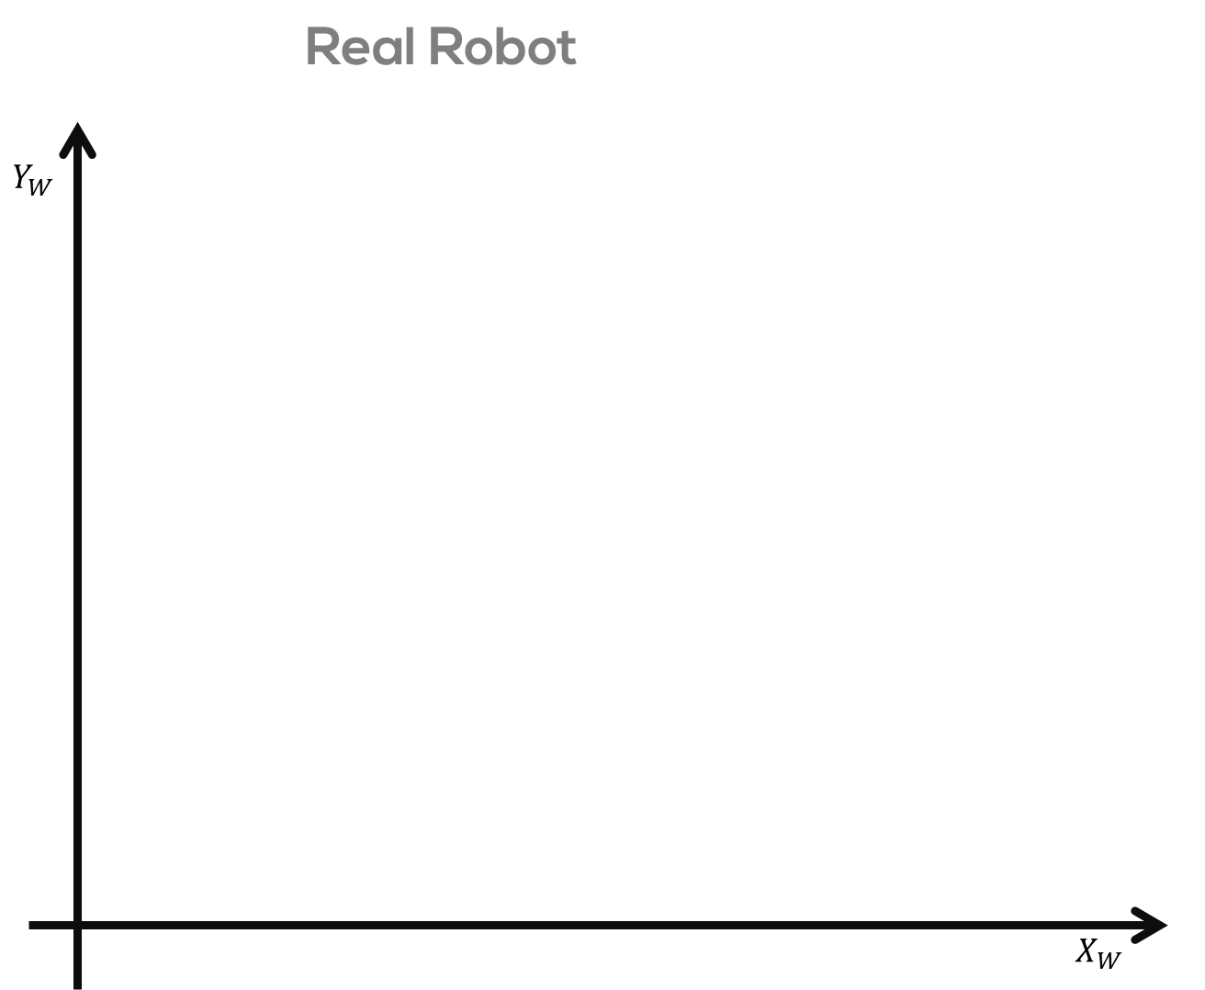
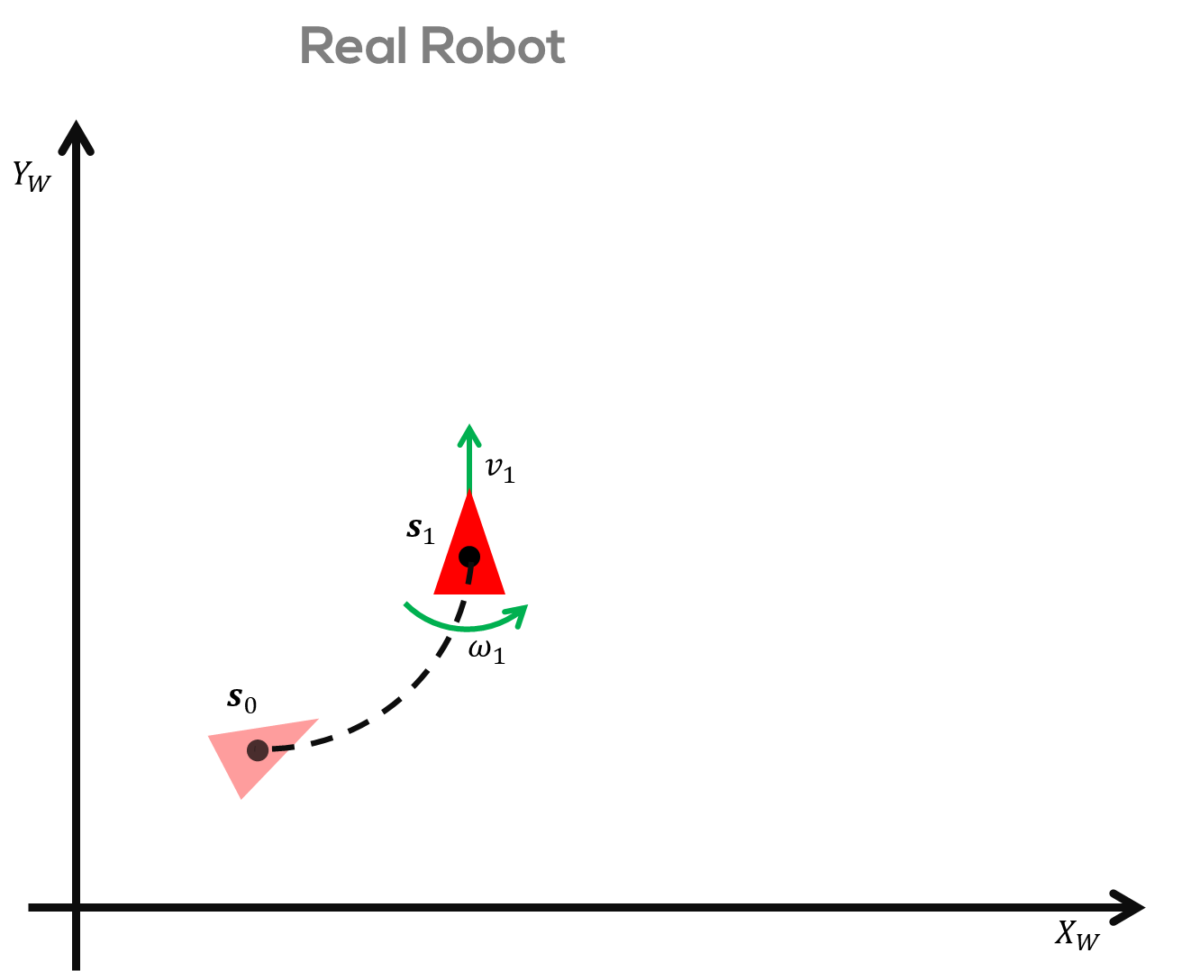
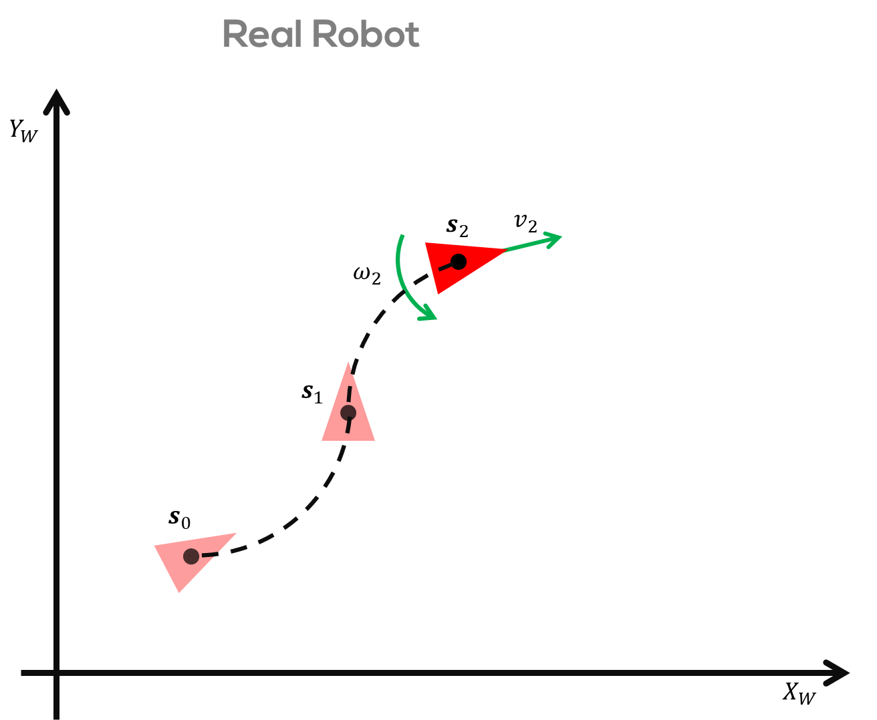
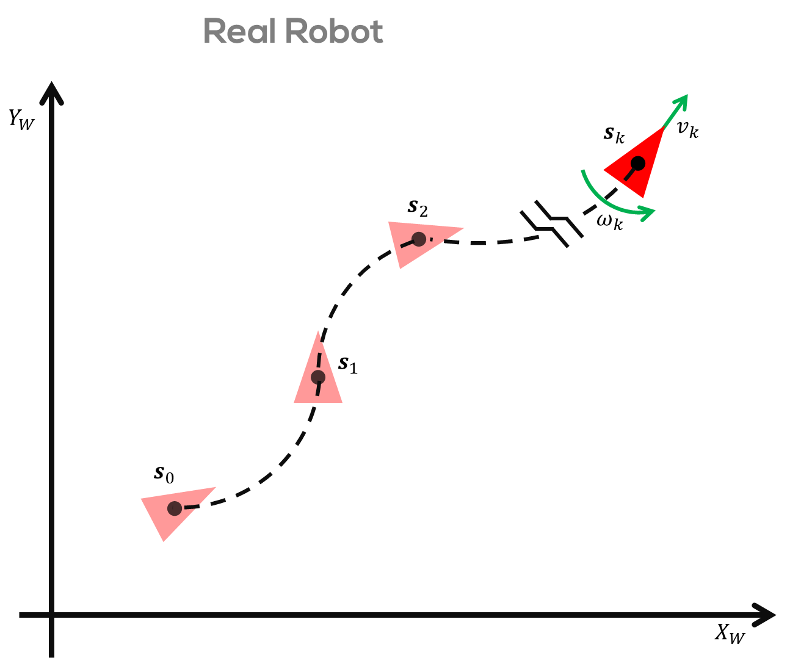
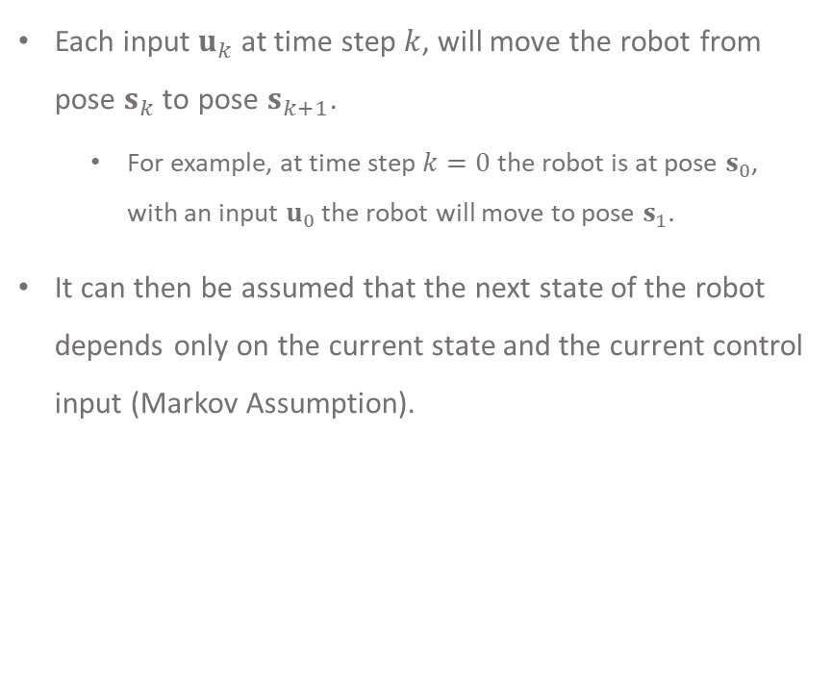
Real Robot
Each input $u_{k}$ at time step $k$, will move the robot from pose $s_{k}$to pose $s_{k+1}$.
For example, at time step $k=0$ the robot is at pose $s_{0}$, with an input $u_{0}$ the robot will move to pose $s_{1}.$
It can then be assumed that the next state of the robot depends only on the current state and the current control input (Markov Assumption).

Slide 11
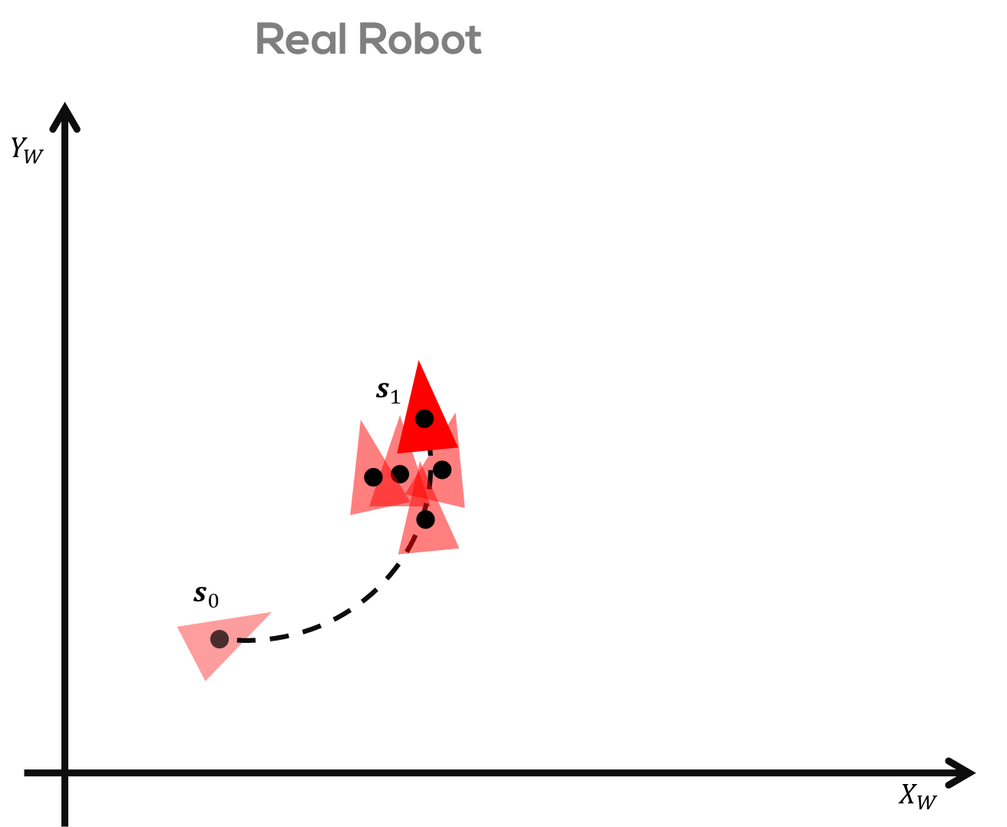
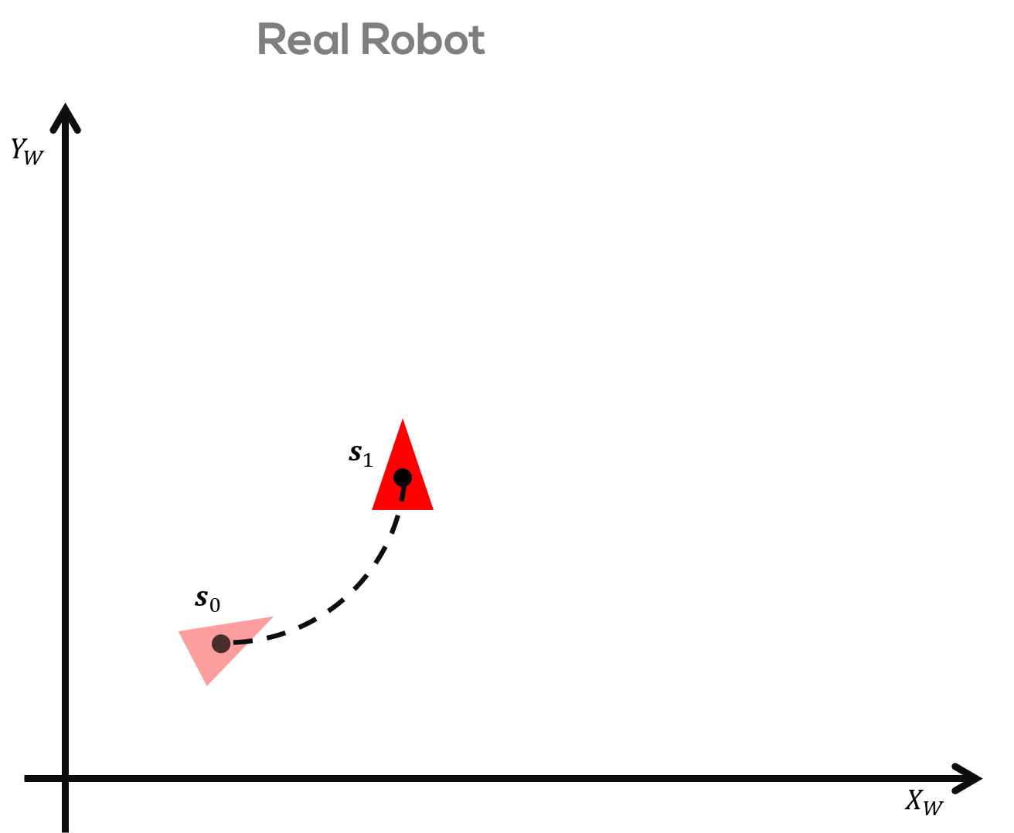
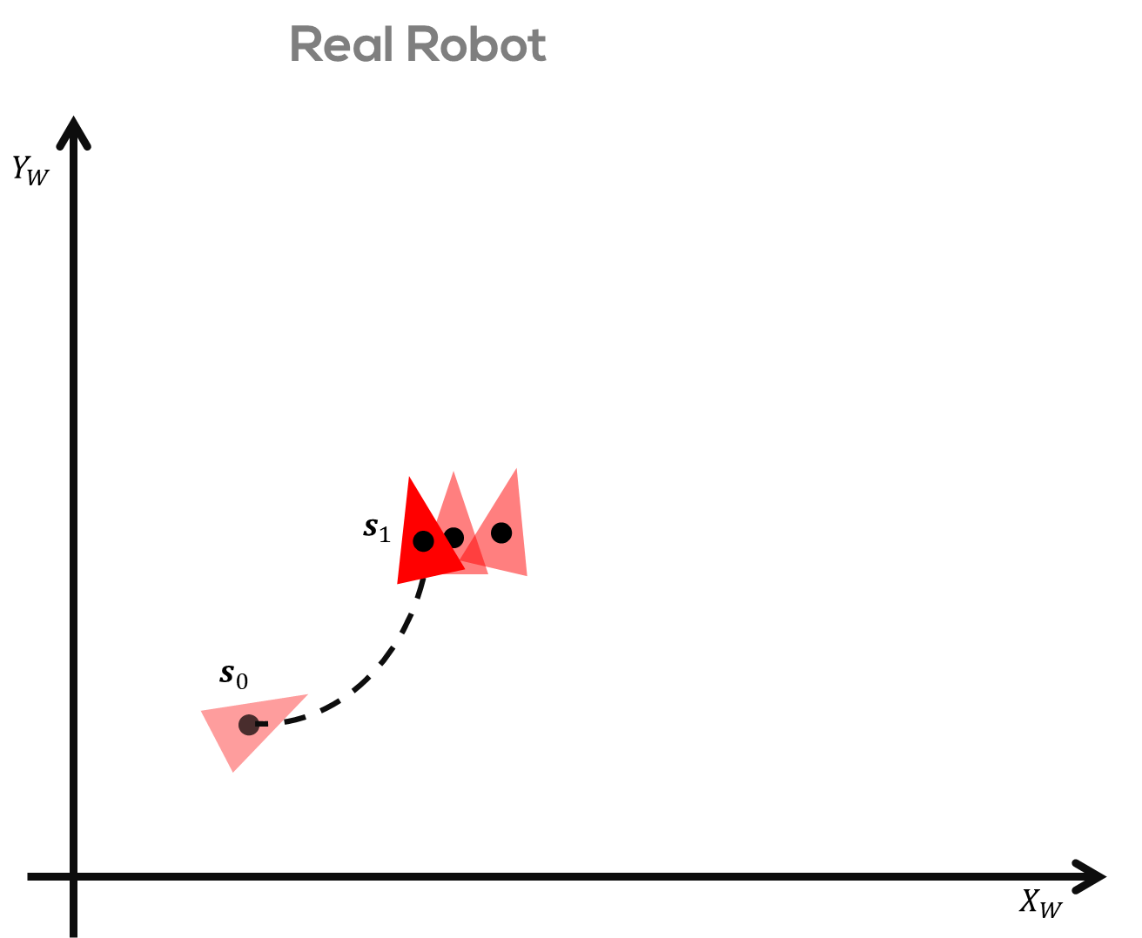
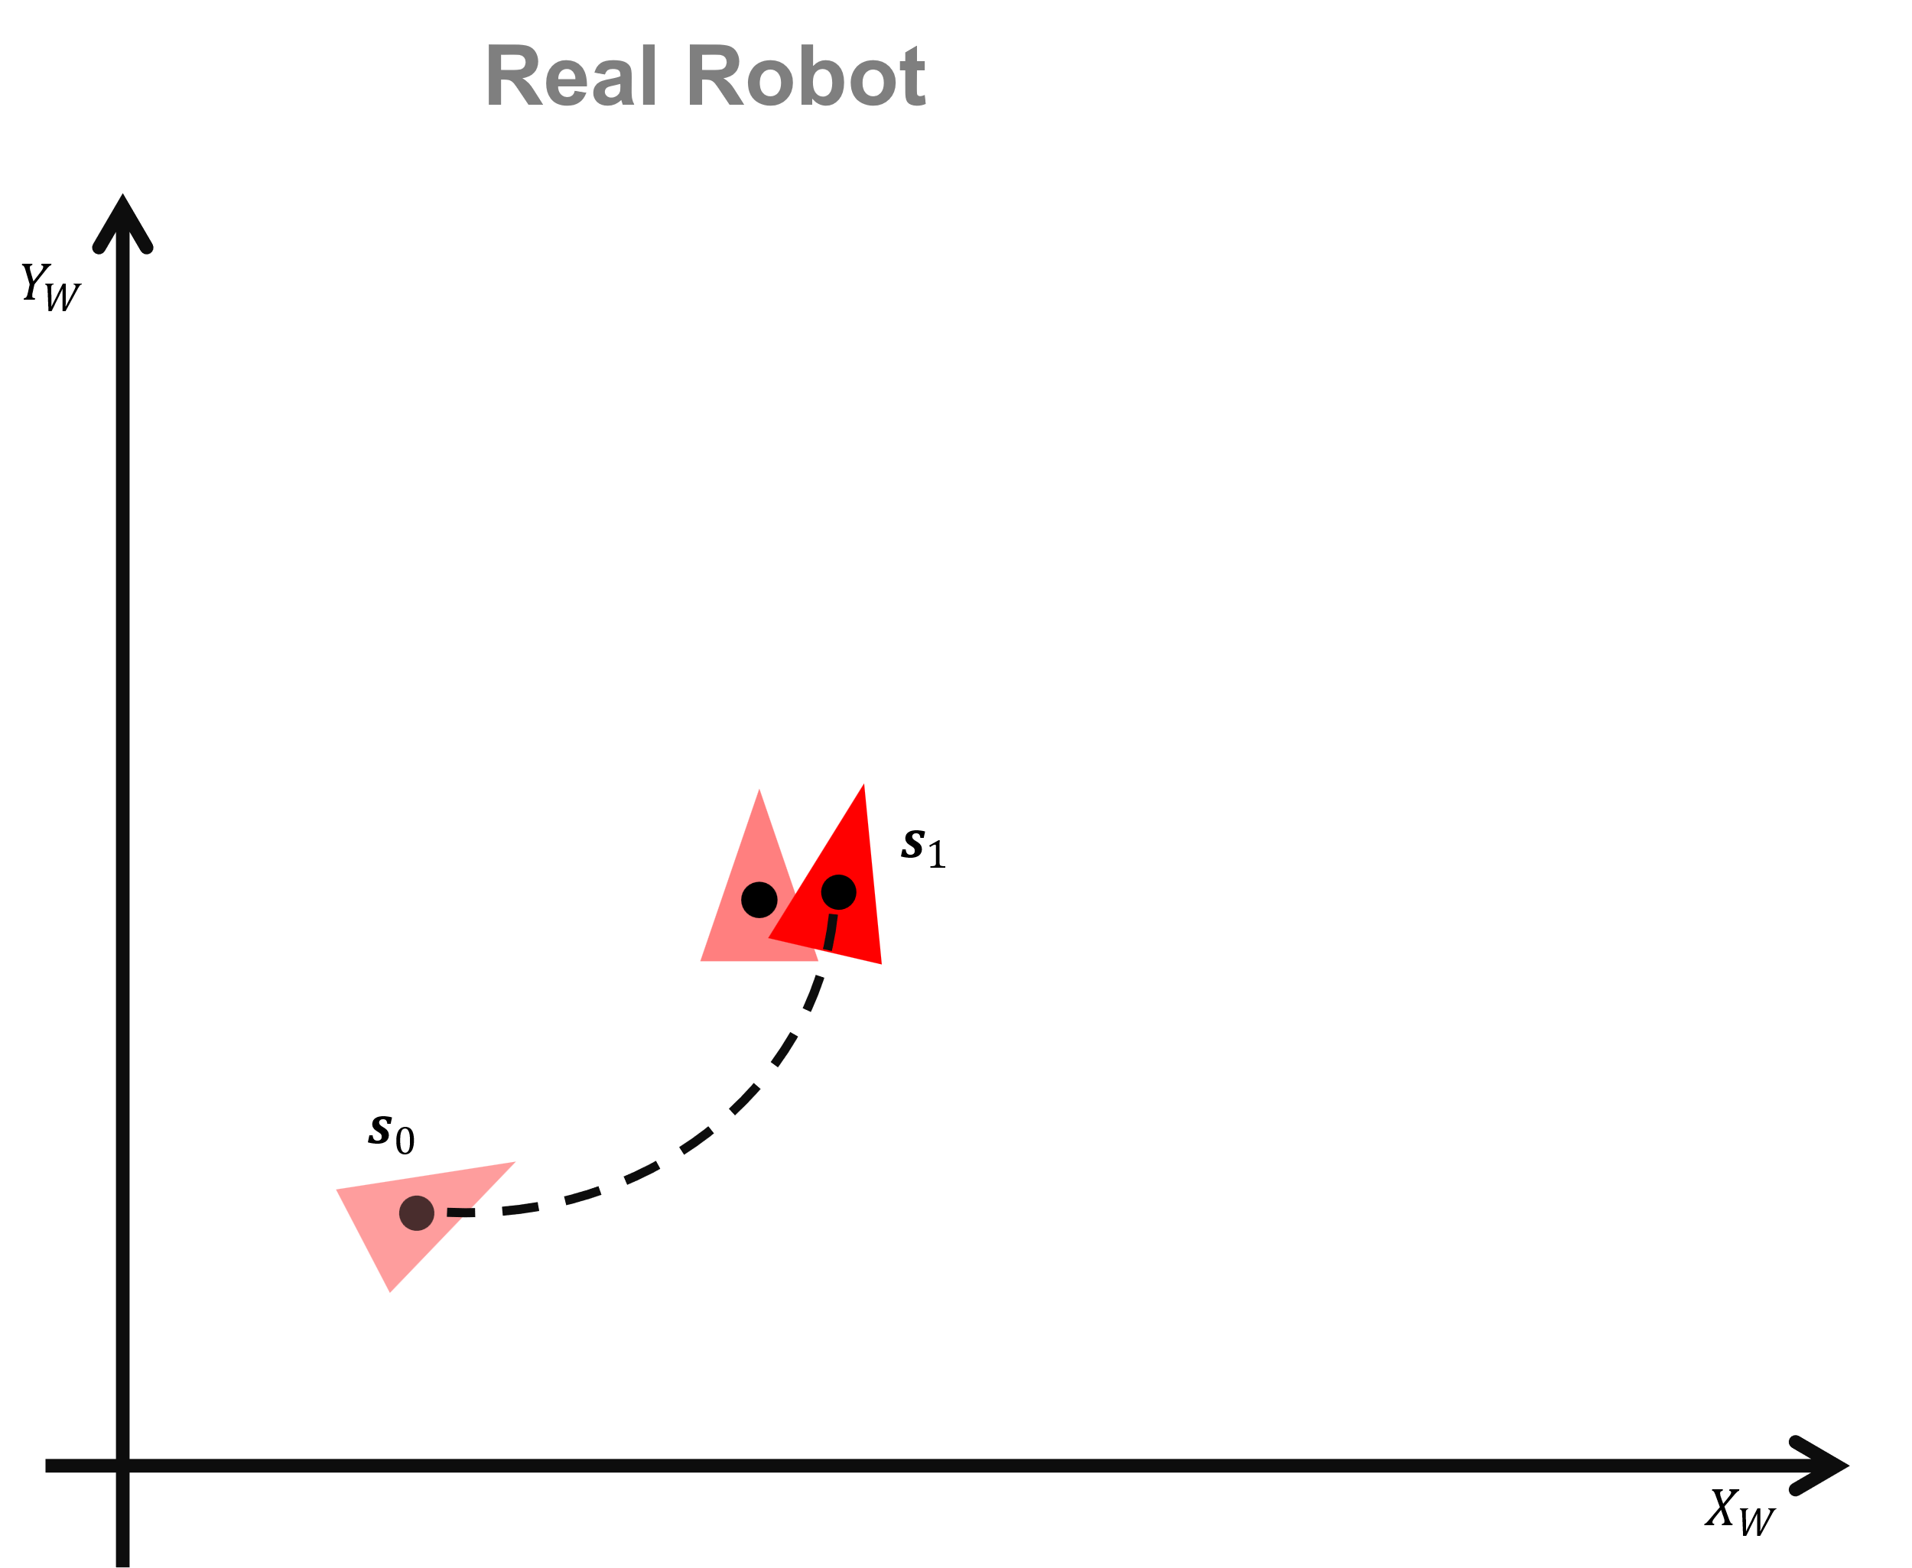
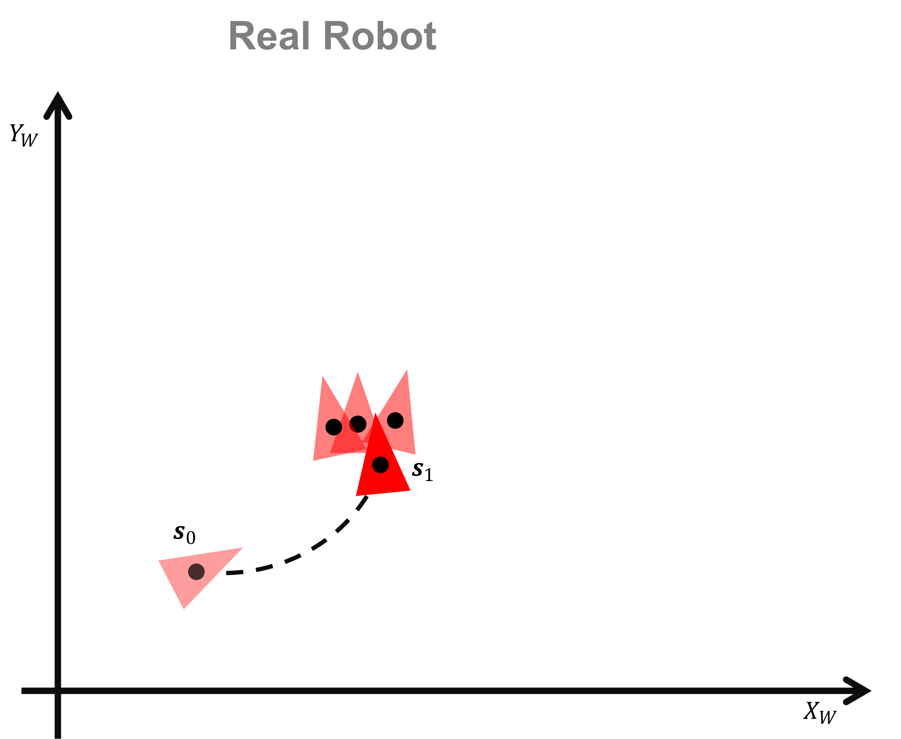
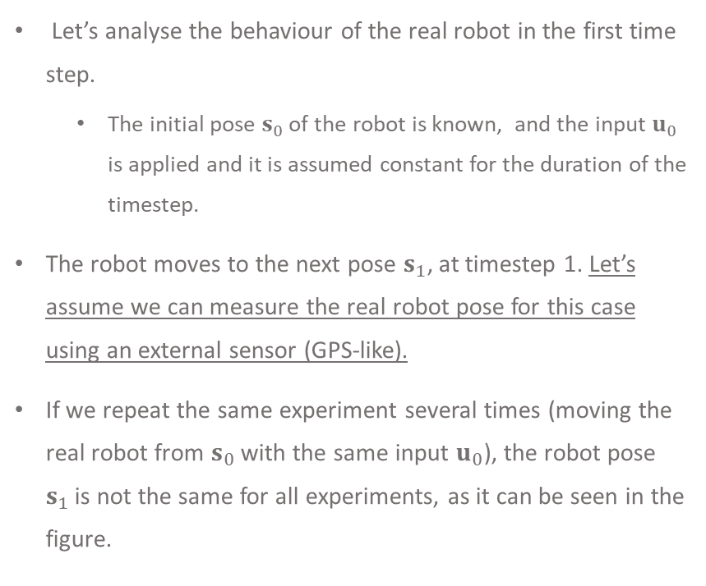
Real Robot
Let’s analyse the behaviour of the real robot in the first time step.
The initial pose $s_{0}$ of the robot is known, and the input $u_{0}$ is applied and it is assumed constant for the duration of the timestep.
The robot moves to the next pose $s_{1}$, at timestep 1. Let’s assume we can measure the real robot pose for this case using an external sensor (GPS-like).
If we repeat the same experiment several times (moving the real robot from $s_{0}$ with the same input $u_{0}$), the robot pose $s_{1}$is not the same for all experiments, as it can be seen in the figure.

Slide 12
Real Robot
This behaviour is due to the nonlinearities and disturbances in the real system making the localisation of the robot difficult to predict.

Slide 13
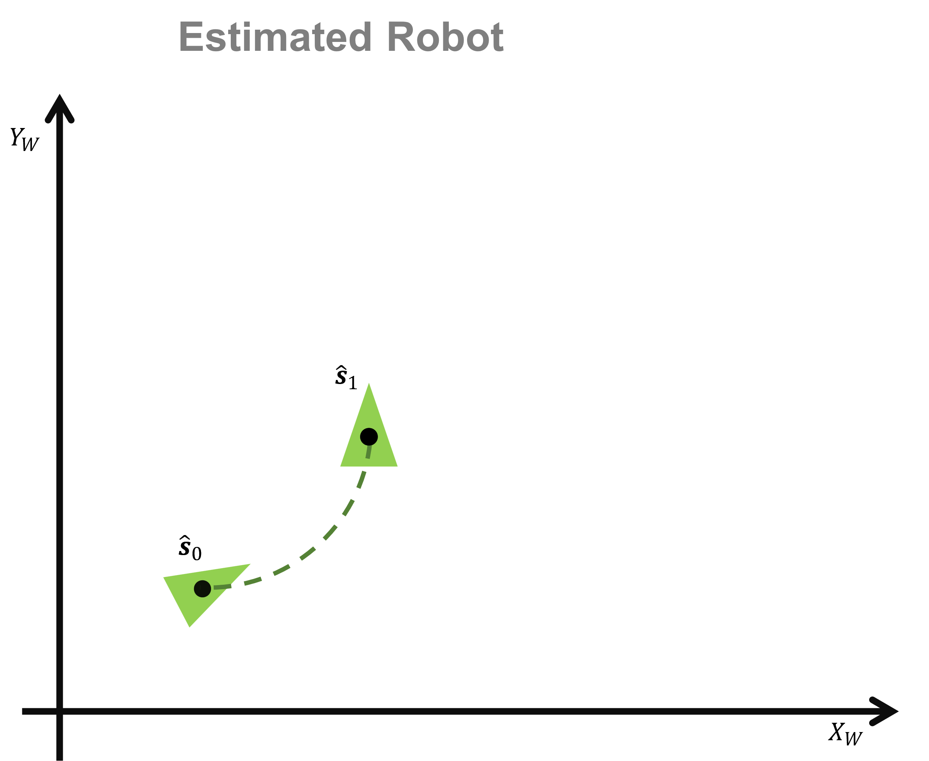
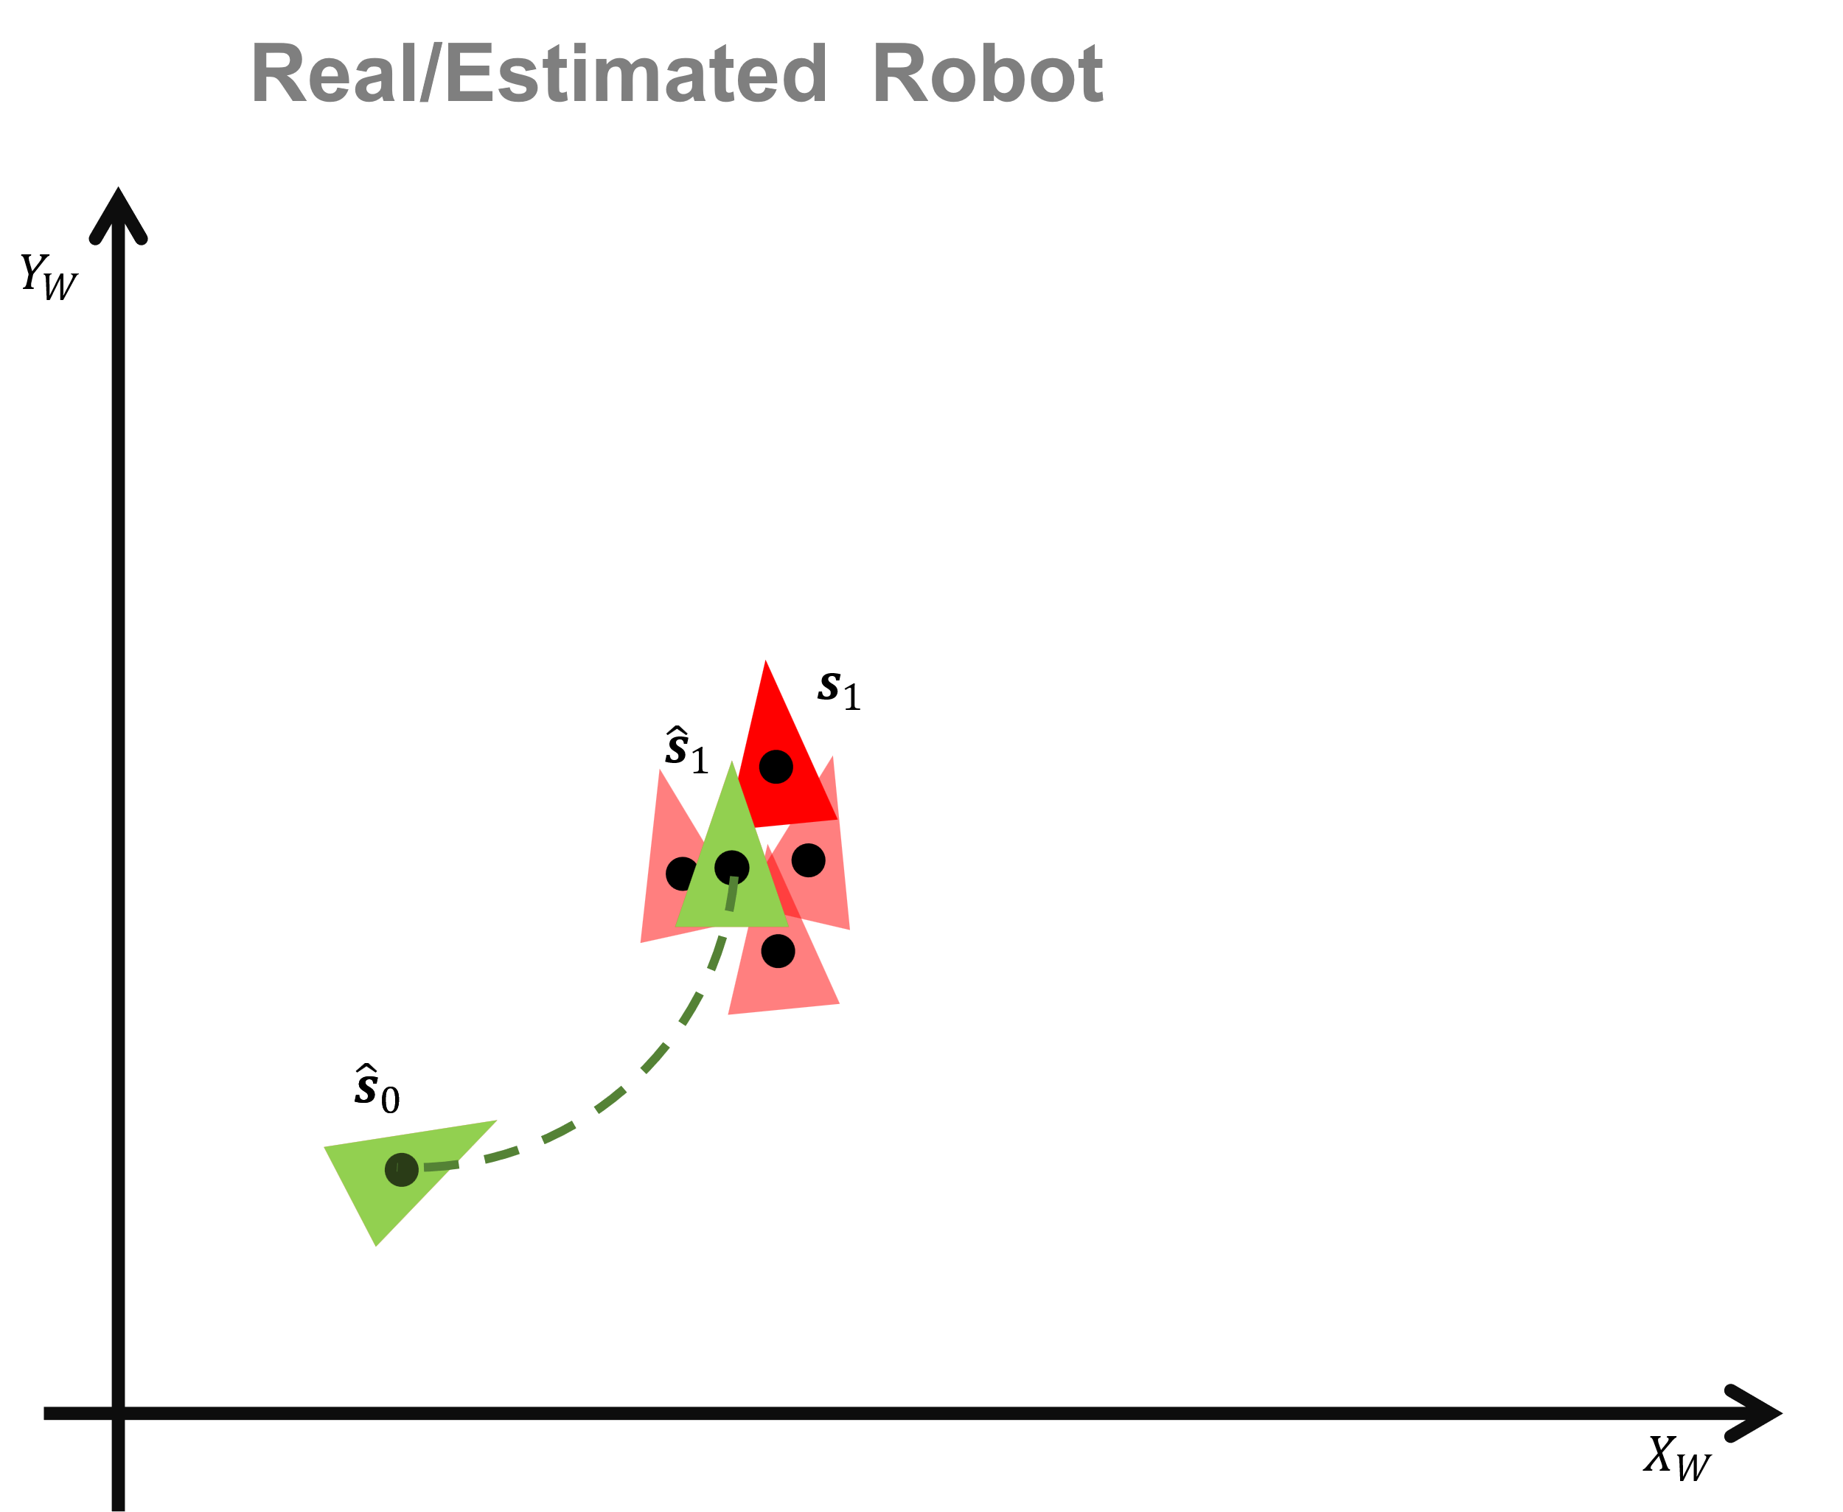
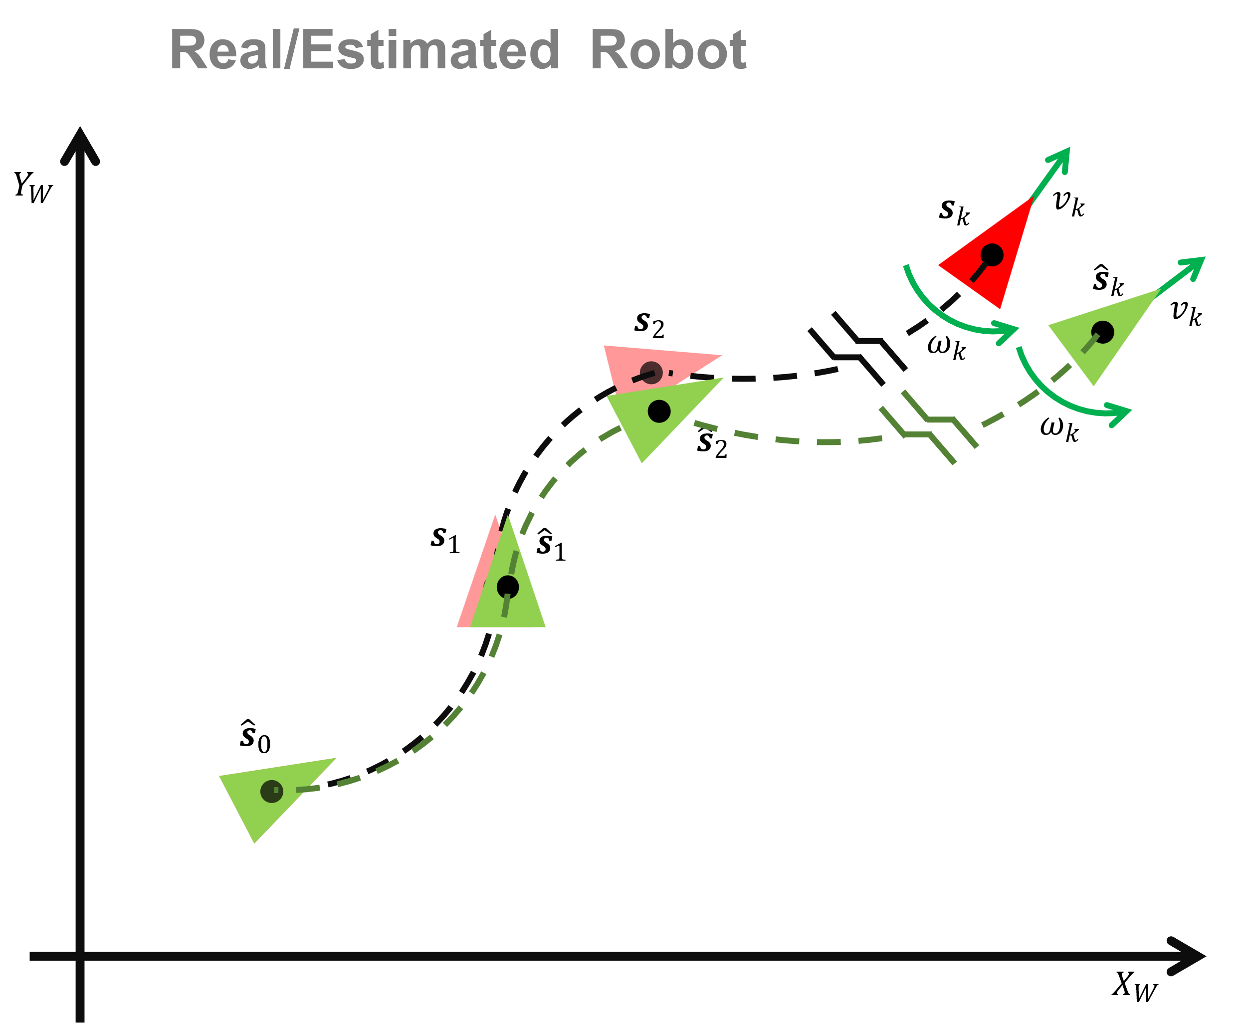
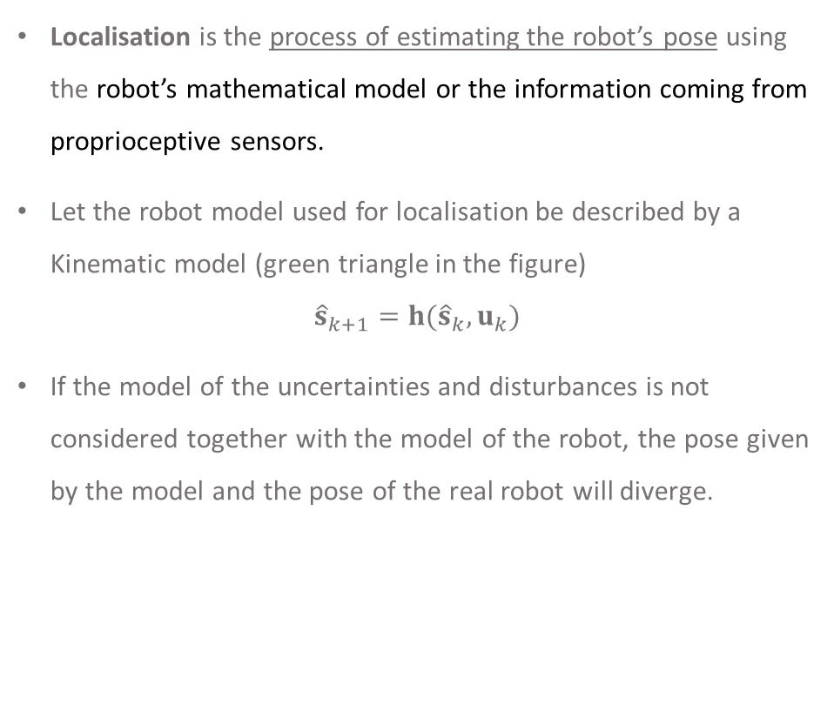
Localisation
Localisation is the process of estimating the robot’s pose using the robot’s mathematical model or the information coming from proprioceptive sensors.
Let the robot model used for localisation be described by a Kinematic model (green triangle in the figure)
$${\hat{s}}_{k+1}=h({\hat{s}}_{k},u_{k})$$
If the model of the uncertainties and disturbances is not considered together with the model of the robot, the pose given by the model and the pose of the real robot will diverge.

Slide 14

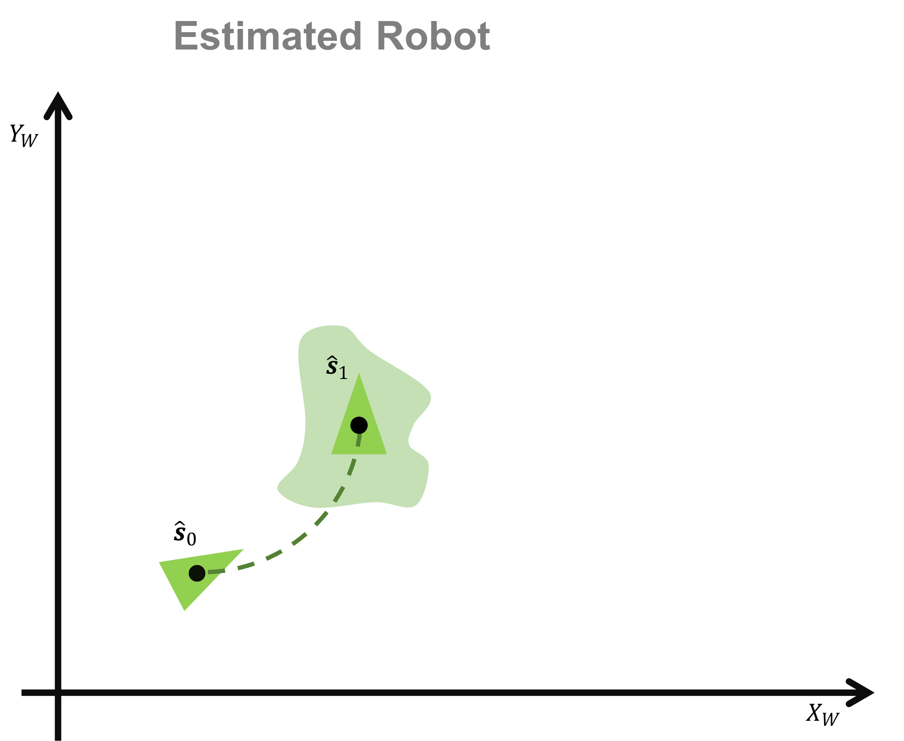
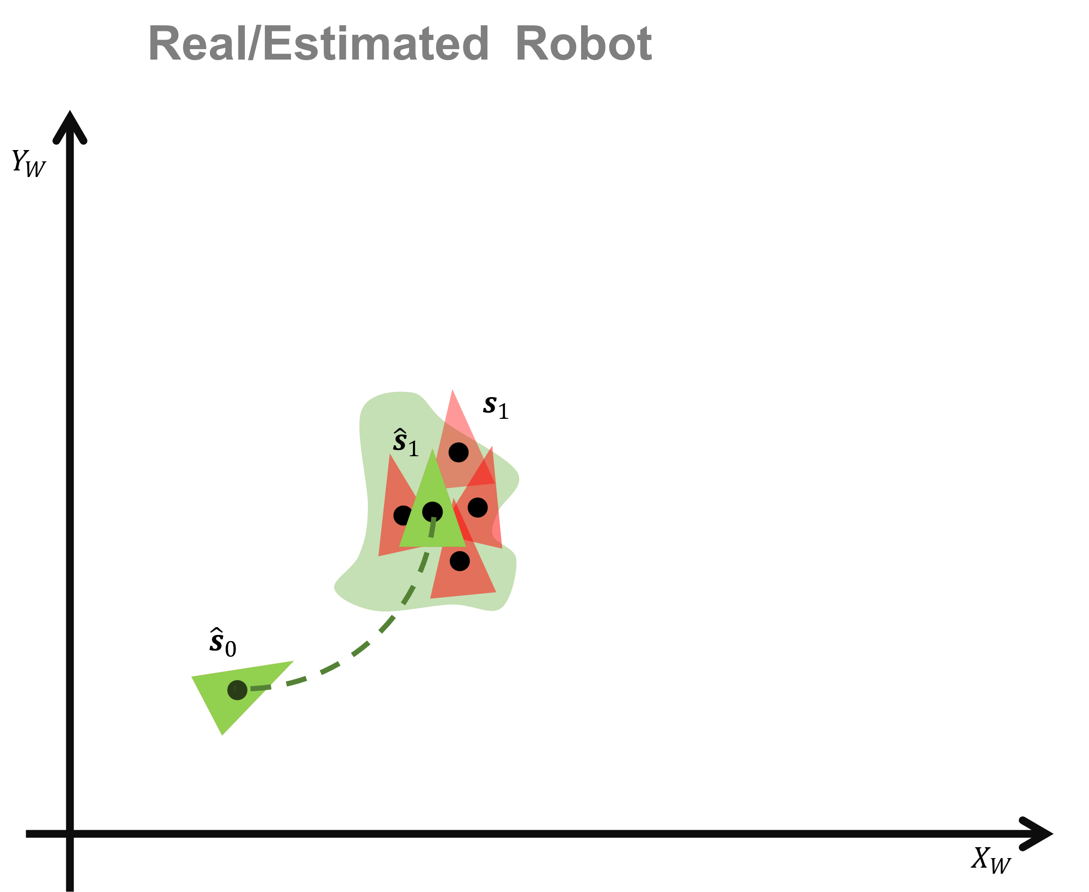
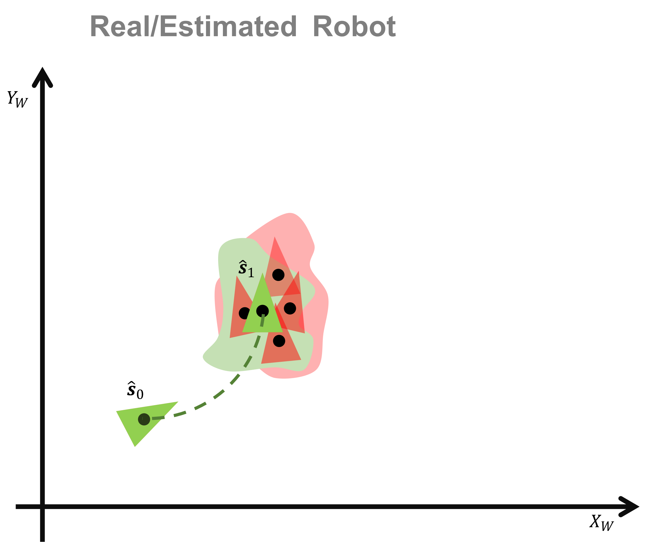
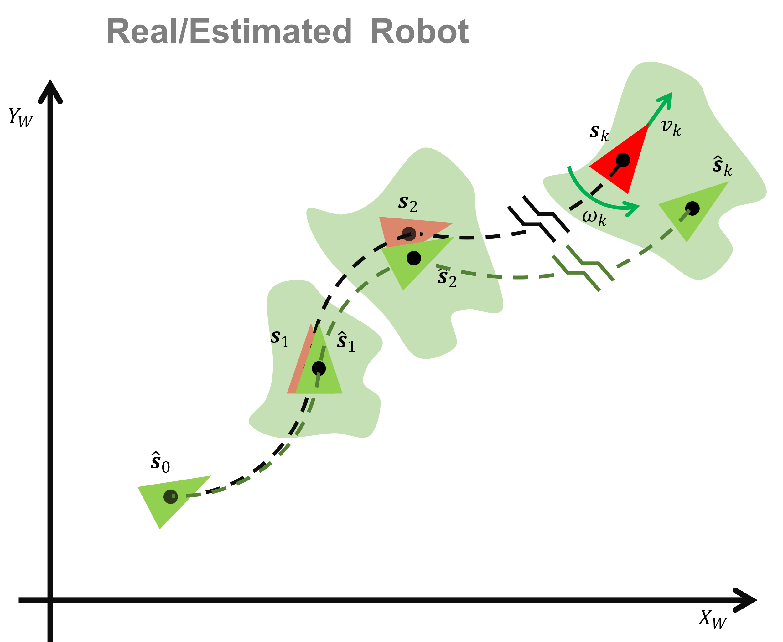
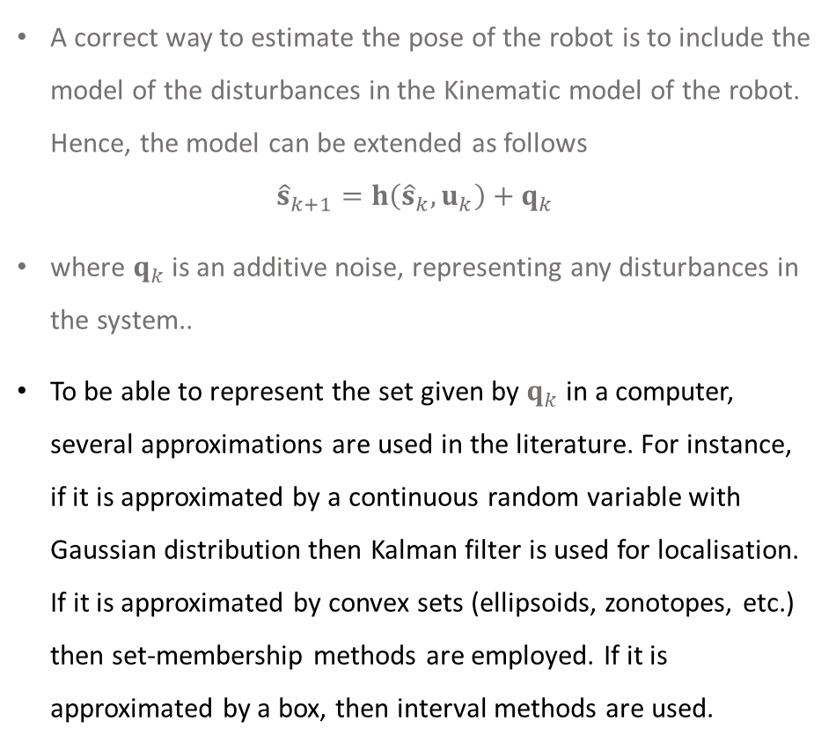
Localisation
A correct way to estimate the pose of the robot is to include the model of the disturbances in the Kinematic model of the robot. Hence, the model can be extended as follows
$${\hat{s}}_{k+1}=h\left({\hat{s}}_{k},u_{k}\right)+q_{k}$$
where $q_{k}$ is an additive noise, representing any disturbances in the system..
To be able to represent the set given by $q_{k}$in a computer, several approximations are used in the literature. For instance, if it is approximated by a continuous random variable with Gaussian distribution then Kalman filter is used for localisation. If it is approximated by convex sets (ellipsoids, zonotopes, etc.) then set-membership methods are employed. If it is approximated by a box, then interval methods are used.

Slide 15
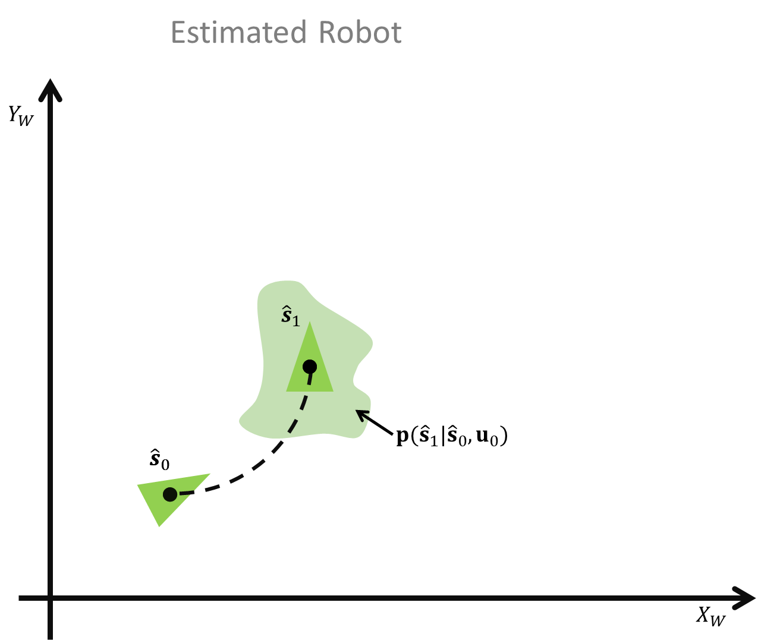
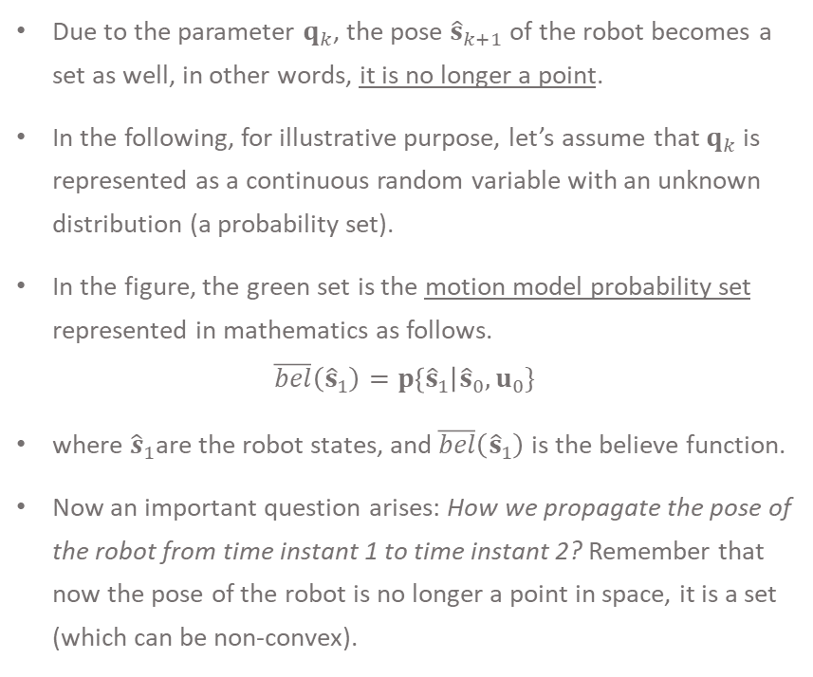
Localisation
Due to the parameter $q_{k}$, the pose ${\hat{s}}_{k+1}$of the robot becomes a set as well, in other words, it is no longer a point.
In the following, for illustrative purpose, let’s assume that $q_{k}$ is represented as a continuous random variable with an unknown distribution (a probability set).
In the figure, the green set is the motion model probability set represented in mathematics as follows.
$$\overline{bel}\left({\hat{s}}_{1}\right)=p\left\{{\hat{s}}_{1}\right|{\hat{s}}_{0}, u_{0}\}$$
where ${\hat{s}}_{1}$are the robot states, and $\overline{bel}\left({\hat{s}}_{1}\right)$ is the believe function.
Now an important question arises: How we propagate the pose of the robot from time instant 1 to time instant 2? Remember that now the pose of the robot is no longer a point in space, it is a set (which can be non-convex).

Slide 16






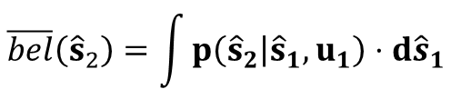


Estimated Robot Pose (dead reckoning)
$$Y_{W}$$
$$\overline{bel}({\hat{s}}_{2})$$
$$\overline{bel}\left({\hat{s}}_{2}\right)=\int{p\left({\hat{s}}_{2} | {\hat{s}}_{1},u_{1}\right)⋅d{\hat{s}}_{1}}$$
$${\hat{s}}_{1}$$
$$p({\hat{s}}_{2}|{\hat{s}}_{1}, u_{1})$$
$$\overline{bel}({\hat{s}}_{1})$$
$$s_{0}$$
$${\hat{s}}_{0}$$
$$X_{W}$$

Slide 17






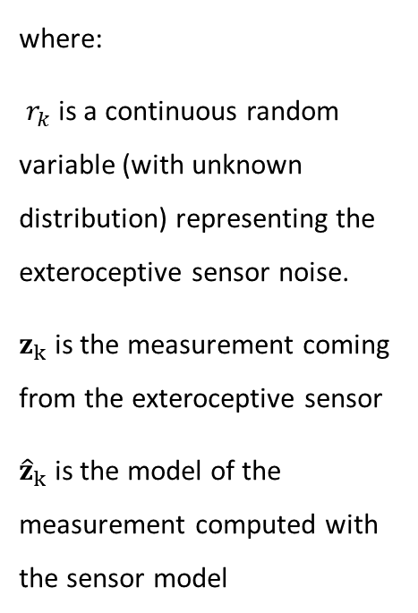






Estimated Robot Pose (exteroceptive measurement)
$$p\left(z_{k} | {\hat{s}}_{k}\right)$$
$$p\left(z_{k} | {\hat{s}}_{k}\right)$$
$$Y_{W}$$
$$z_{k}={\hat{z}}_{k}+r_{k}$$
$$p\left(z_{2} | {\hat{s}}_{2}\right)$$
$${\hat{z}}_{k}=g(m_{i},{\hat{μ}}_{k})$$
$${\hat{z}}_{k}$$
where:
$r_{k}$ is a continuous random variable (with unknown distribution) representing the exteroceptive sensor noise.
$z_{k}$ is the measurement coming from the exteroceptive sensor
${\hat{z}}_{k}$ is the model of the measurement computed with the sensor model
$${\hat{s}}_{2}$$
$${\hat{z}}_{2}$$
$$(m_{x},my)$$
$${\hat{z}}_{1}$$
$${\hat{s}}_{1}$$
$$p\left(z_{1} | {\hat{s}}_{1}\right)$$
$$s_{0}$$
$${\hat{s}}_{0}$$
$$X_{W}$$

Slide 18






Estimated Robot
$$Y_{W}$$
$$z_{2}={\hat{z}}_{2}+r_{2}$$
$$p\left({\hat{z}}_{2} | {\hat{s}}_{2}\right)$$
$$z_{2}$$
$$(m_{x},my)$$
$$\overline{bel}\left({\hat{s}}_{2}\right)=p({\hat{s}}_{2}|{\hat{s}}_{1}, u_{1})$$
$${\hat{s}}_{1}$$
$$bel({\hat{s}}_{1})$$
$$s_{0}$$
$${\hat{s}}_{0}$$
$$X_{W}$$

Slide 19


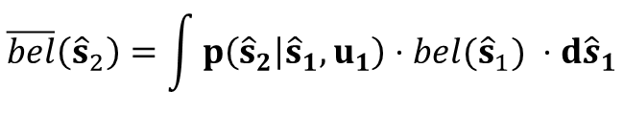




Bayes filter:
Prediction:
$$\overline{bel}\left({\hat{s}}_{2}\right)=\int{p\left({\hat{s}}_{2} | {\hat{s}}_{1},u_{1}\right)⋅bel({\hat{s}}_{1}) ⋅d{\hat{s}}_{1}}$$
Estimated Pose of the Robot
Correction:
$$Y_{W}$$
$$bel\left({\hat{s}}_{2}\right)= η∙p\left(z_{k} | {\hat{s}}_{2}\right)∙\overline{bel }\left({\hat{s}}_{2}\right)$$
$$bel({\hat{s}}_{2})$$
$$(m_{x},my)$$
$$(m_{x},my)$$
How can we implement this filter in a computer (as an iterative algorithm)?
$${\hat{s}}_{1}$$
$$bel({\hat{s}}_{1})$$
$${\hat{s}}_{0}$$
$$X_{W}$$

Slide 20
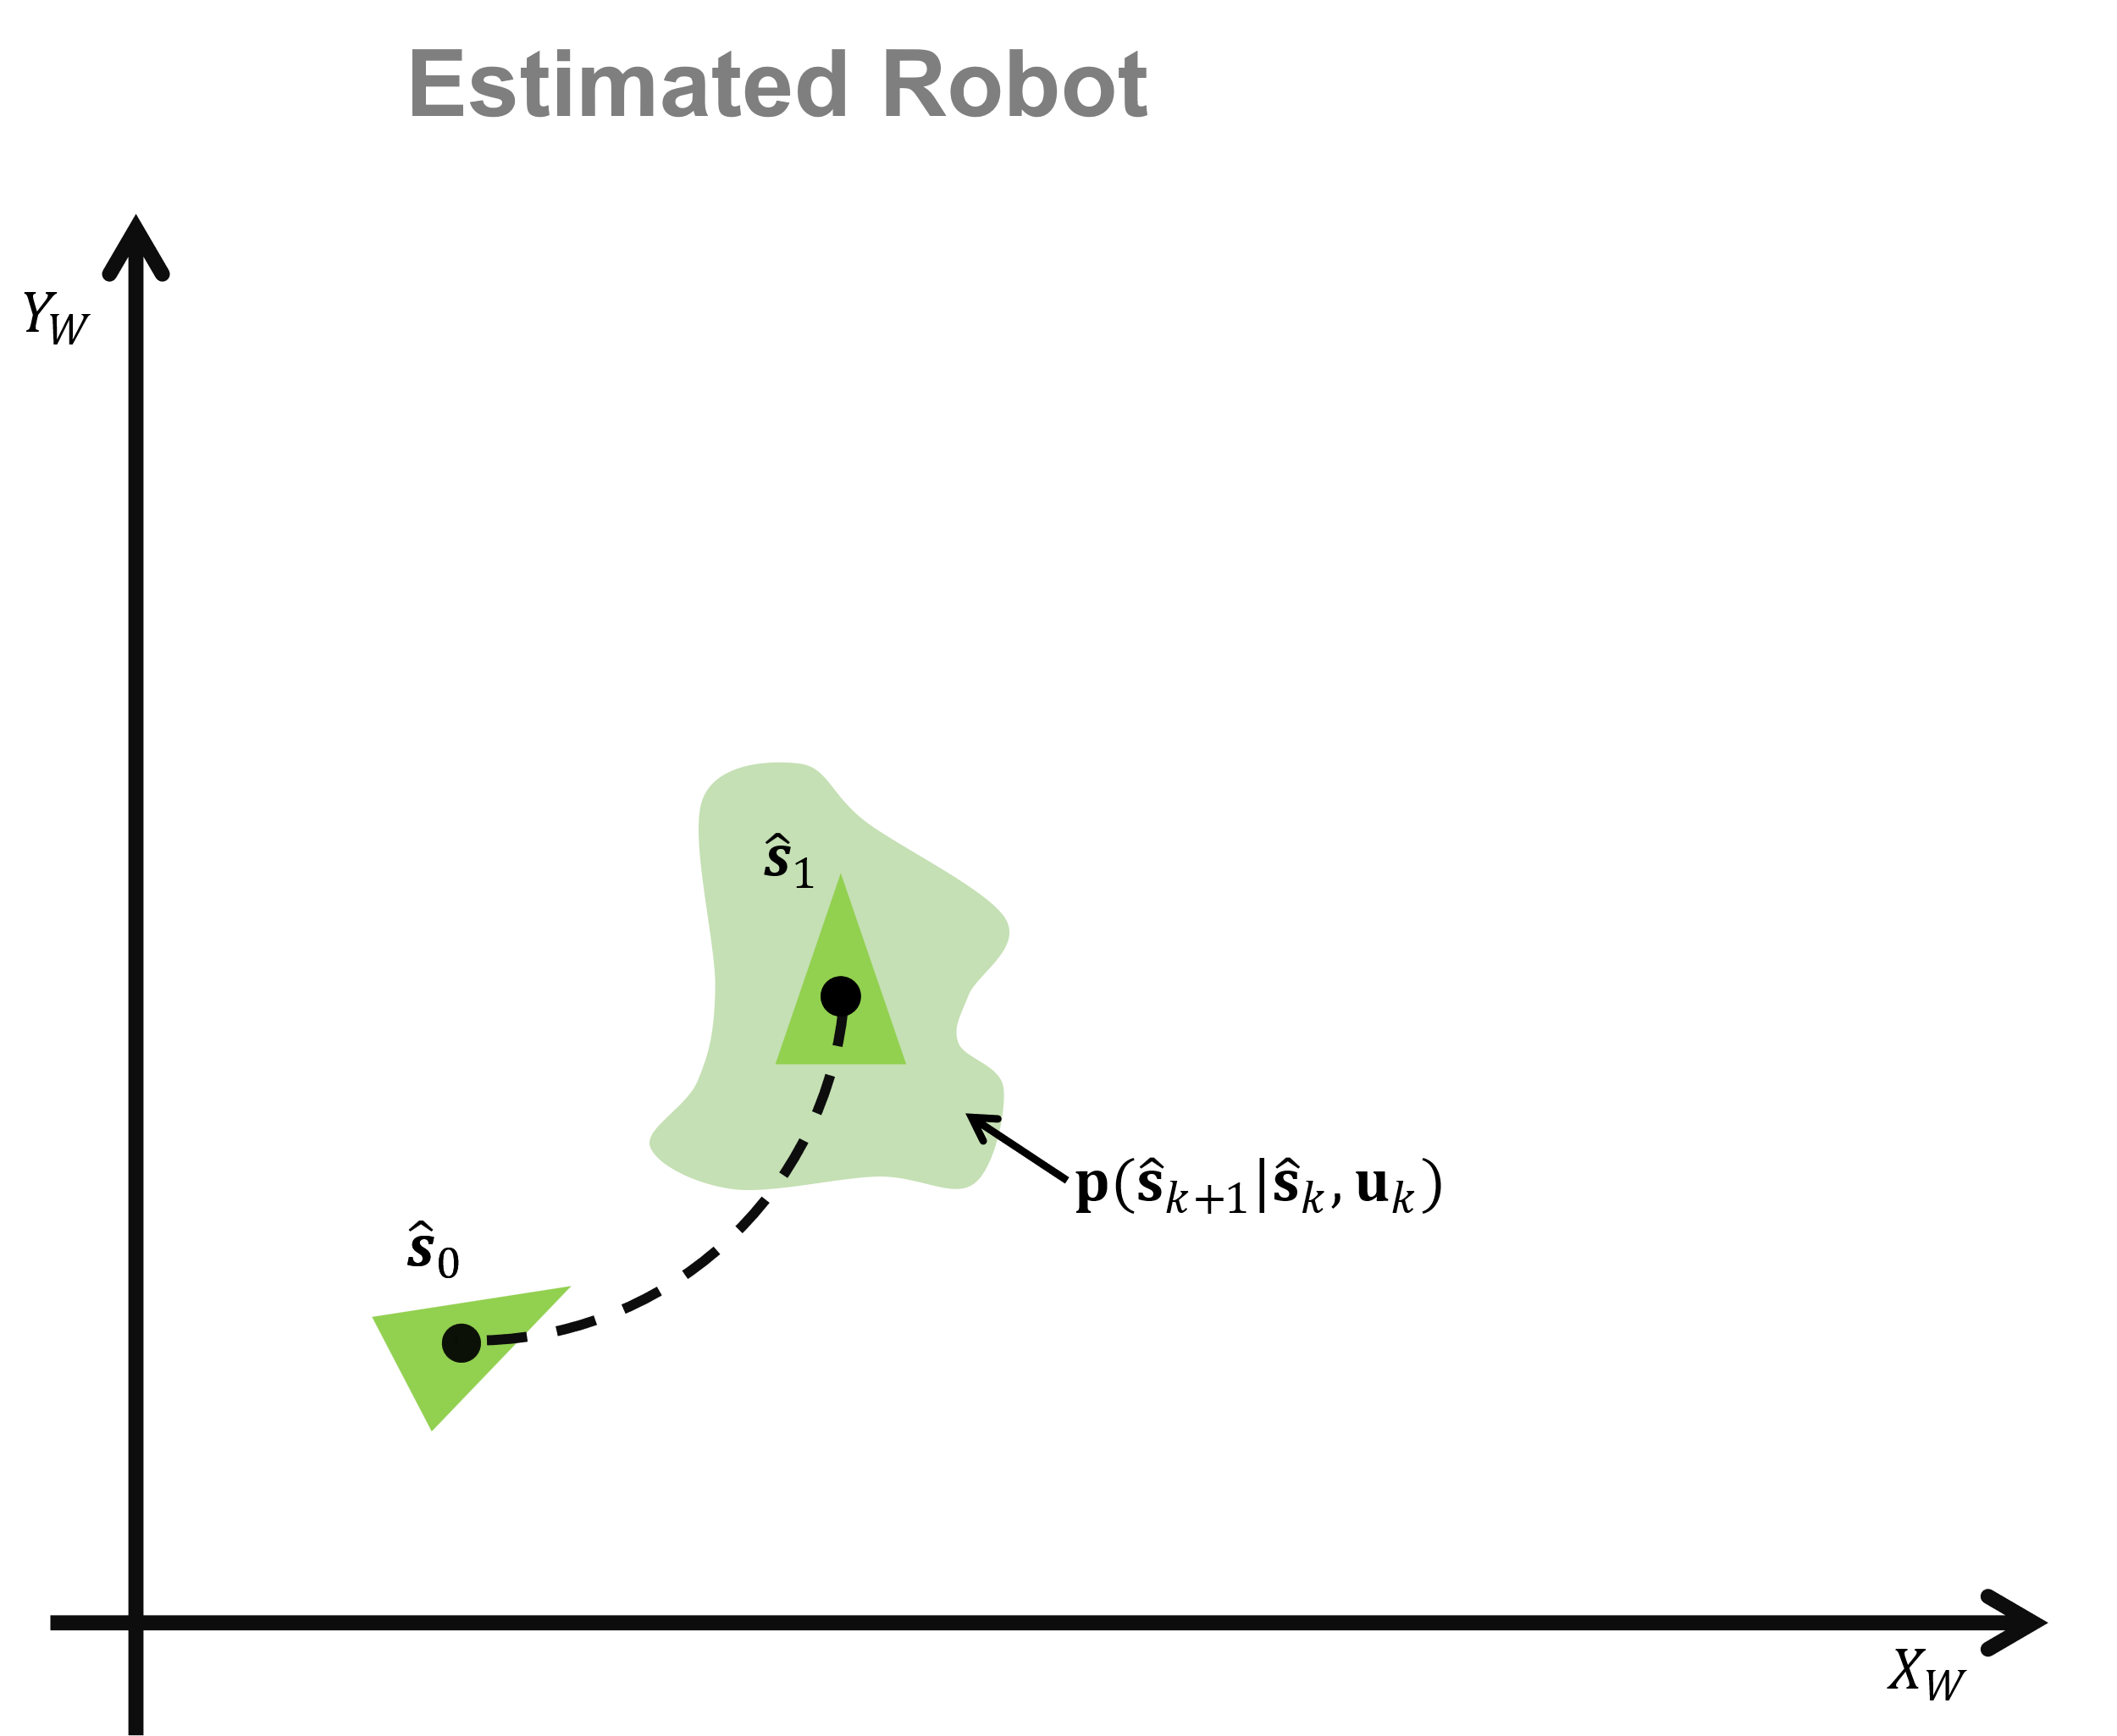
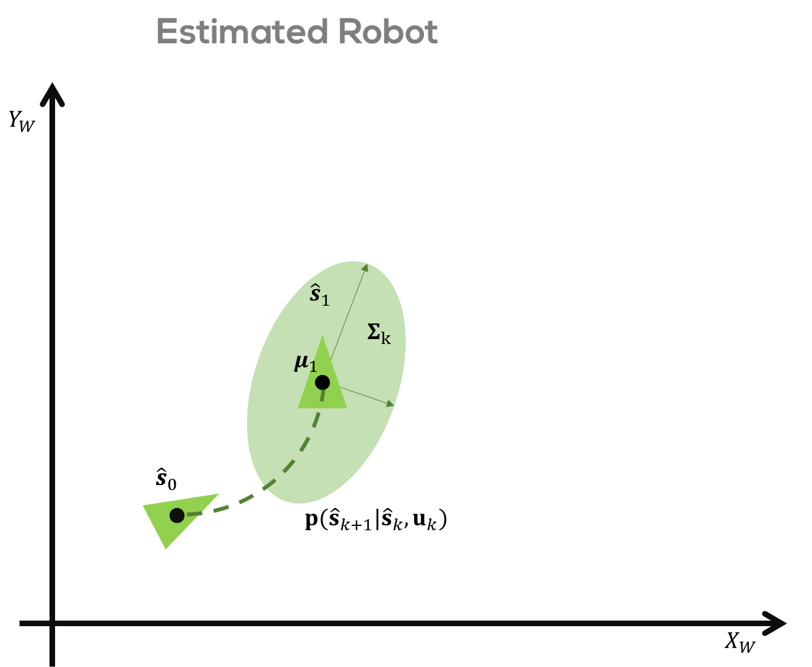

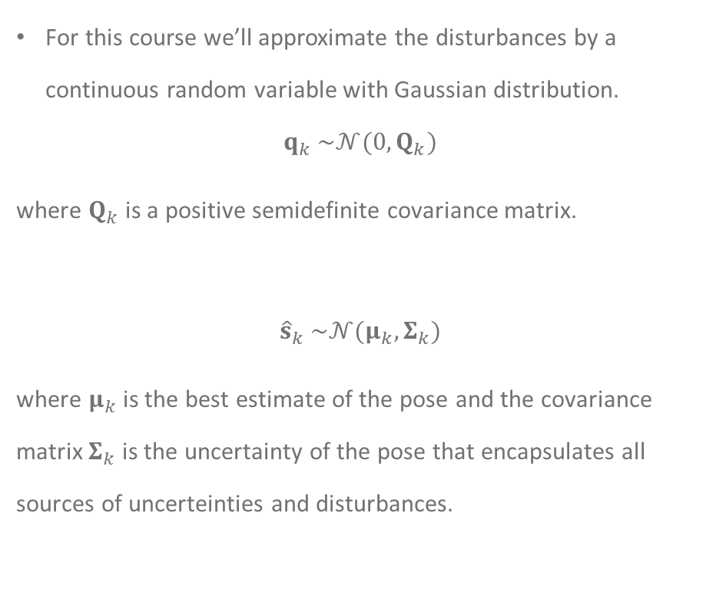
Map-based Localisation
For this course we’ll approximate the disturbances by a continuous random variable with Gaussian distribution.
$$q_{k} \sim 𝒩(0,Q_{k})$$
where $Q_{k}$ is a positive semidefinite covariance matrix.
$${\hat{s}}_{k} \sim 𝒩(μ_{k},Σ_{k})$$
where $μ_{k}$ is the best estimate of the pose and the covariance matrix $Σ_{k}$ is the uncertainty of the pose that encapsulates all sources of uncerteinties and disturbances.

Slide 21

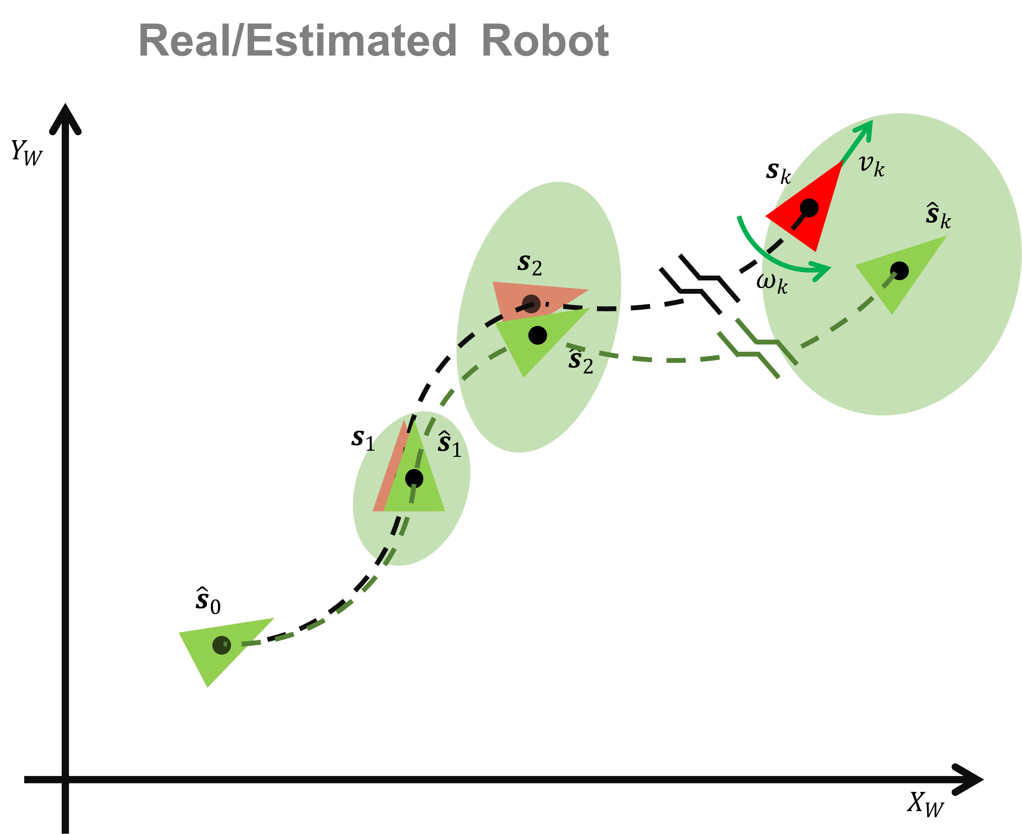
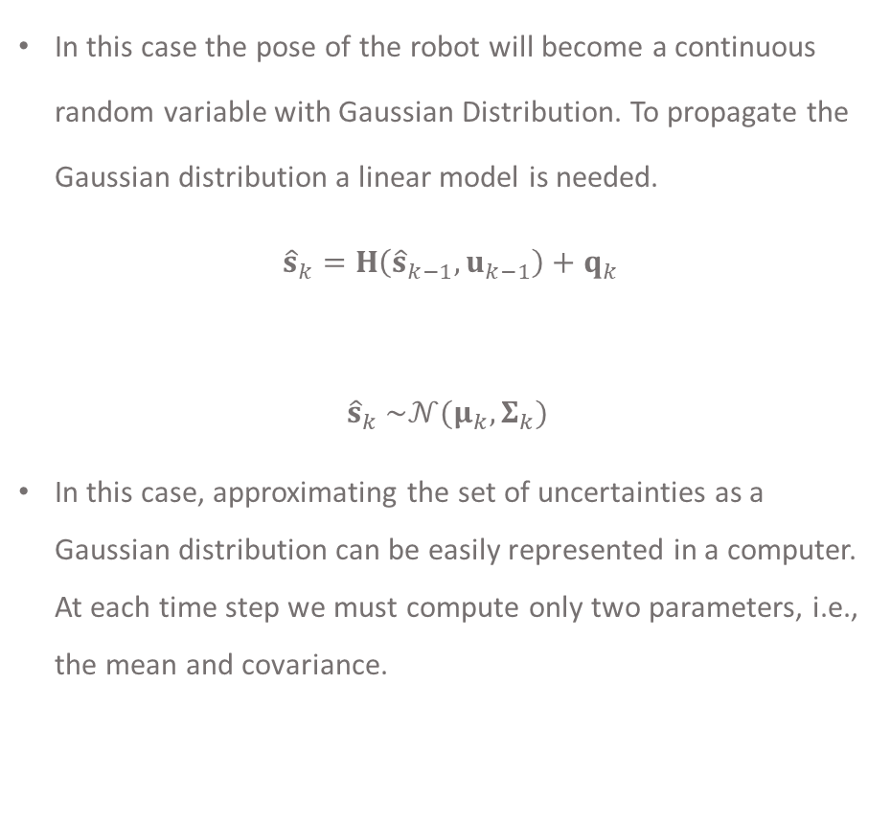
Map-based Localisation
In this case the pose of the robot will become a continuous random variable with Gaussian Distribution. To propagate the Gaussian distribution a linear model is needed.
${\hat{s}}_{k}=H\left({\hat{s}}_{k−1},u_{k−1}\right)+q_{k}$
$${\hat{s}}_{k} \sim 𝒩(μ_{k},Σ_{k})$$
In this case, approximating the set of uncertainties as a Gaussian distribution can be easily represented in a computer. At each time step we must compute only two parameters, i.e., the mean and covariance.

Slide 22
Kalman Filter
A Geometric Approach

Slide 23
Kalman Filter assumptions:
Linear models and Gaussian noise
If the models are nonlinear then a linearisation is needed and the localisation method is Extended Kalman Filter.

Slide 24








Estimated Robot
$$Y_{W}$$
$$Σ_{1}$$
$$μ_{1}$$
$${\hat{s}}_{1}$$
$$s_{0}$$
$${\hat{s}}_{0}$$
$$p({\hat{s}}_{k+1}|{\hat{s}}_{k}, u_{k})$$
$$X_{W}$$

Slide 25










Estimated Robot
$$Y_{W}$$
$$Σ_{2}$$
$$landmark$$
$$μ_{2}$$
$$\overline{bel}({\hat{s}}_{2})$$
$$Σ_{1}$$
$$p({\hat{s}}_{2}|{\hat{s}}_{1}, u_{1})$$
$$μ_{1}$$
$${\hat{s}}_{1}$$
$$\overline{bel}({\hat{s}}_{1})$$
$$μ_{0}$$
$$Σ_{0}=0$$
$${\hat{s}}_{0}$$
$$X_{W}$$

Slide 26
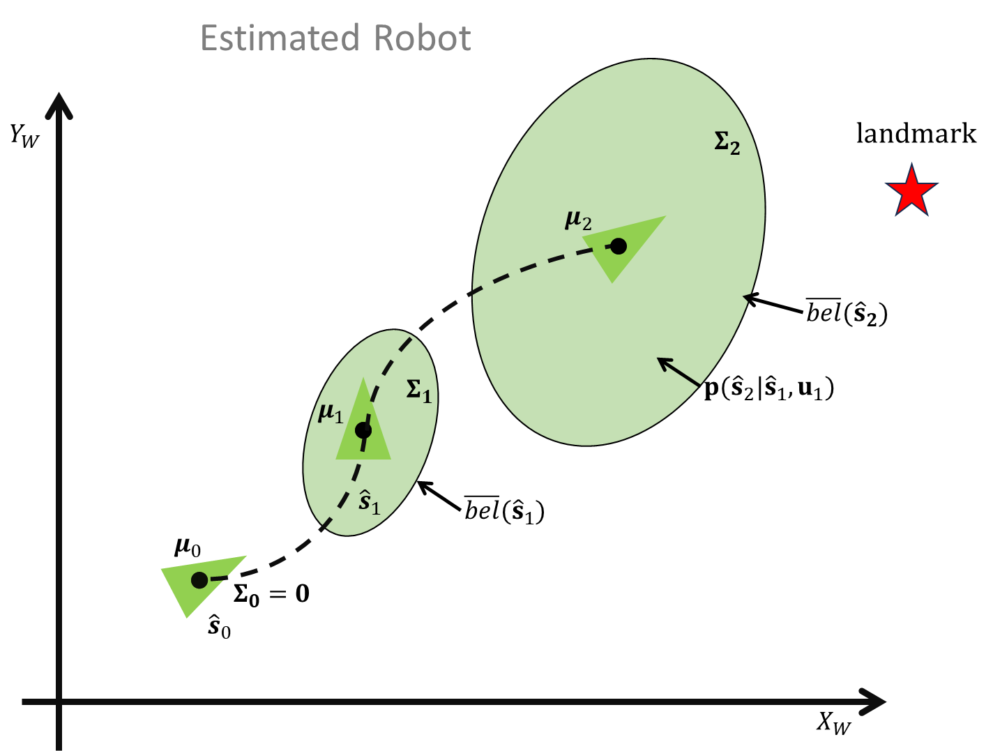

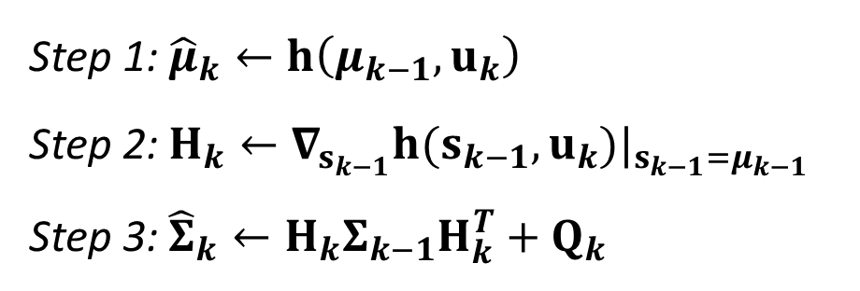

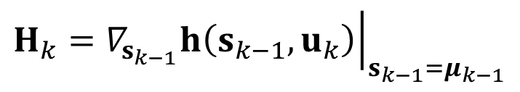
$$Prediction:$$
Step 1: ${\hat{μ}}_{k}←h\left(μ_{k−1},u_{k}\right)$
Step 2: $H_{k}←∇_{s_{k−1}}h(s_{k−1}, u_{k})|_{s_{k−1}=μ_{k−1}}$
Step 3: ${\hat{Σ}}_{k}←H_{k}Σ_{k−1}H_{k}^{T}+Q_{k}$
$$where:$$
$$H_{k}={\left.∇_{s_{k−1}}h\left(s_{k−1},u_{k}\right)\right|}_{s_{k−1}=μ_{k−1}}$$

Slide 27


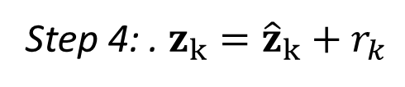
















$$Correction:$$
Step 4: . $z_{k}={\hat{z}}_{k}+r_{k}$
Measurement
$$where:$$
$$Y_{W}$$
$$z_{k}$$
$$p({\hat{z}}_{k}|s_{k})$$
$$pose ???$$
$${\hat{z}}_{k}=g(m_{i},{\hat{μ}}_{k})$$
$$R_{k}$$
$$μ_{k}$$
$$r_{k}\sim 𝒩\left(0,R_{k}\right)$$
$$g(m_{i},{\hat{μ}}_{k})$$
Propagation
$$μ_{{\hat{s}}_{k}|z_{k}}$$
Observation model
$$Σ_{k}$$
$$p(s_{k}|U_{k},Z_{k−1})$$
$$μ_{k−1}$$
$$Σ_{k−1}$$
$$p(s_{k−1}|U_{k−1},Z_{k−1})$$
$$X_{W}$$

Slide 28


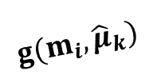












$$p({\hat{s}}_{k}|z_{k})$$
Measurement
$$Y_{W}$$
$$z_{k}$$
$$p({\hat{z}}_{k}|s_{k})$$
$$Σ_{{\hat{s}}_{k}|z_{k}}$$
$$R_{k}$$
$${\hat{μ}}_{k}$$
$$g(m_{i},{\hat{μ}}_{k})$$
$$μ_{{\hat{s}}_{k}|z_{k}}$$
Propagation
Observation model
$$Σ_{k}$$
$$p(s_{k}|U_{k},Z_{k−1})$$
$$μ_{k−1}$$
$$Σ_{k−1}$$
$$p(s_{k−1}|U_{k−1},Z_{k−1})$$
$$X_{W}$$

Slide 29
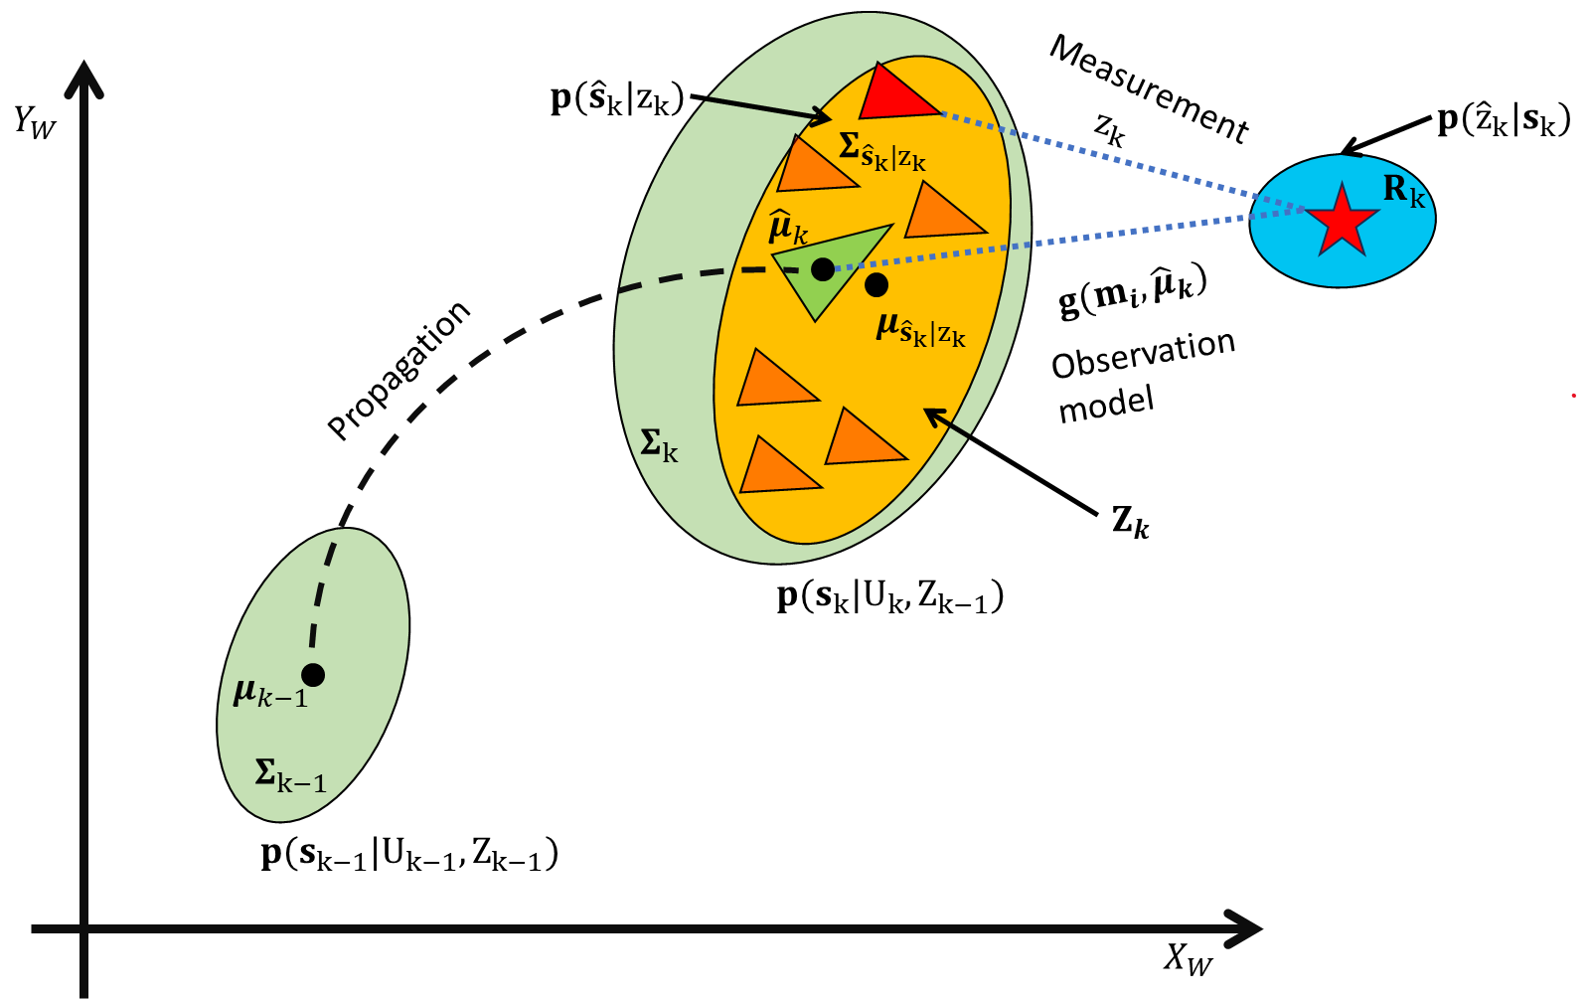
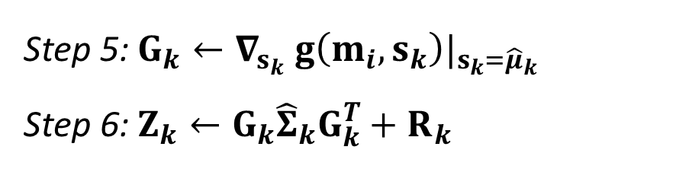
$$Correction:$$
Step 5: $G_{k}←∇_{s_{k}} g\left(m_{i},s_{k}\right)|_{s_{k}={\hat{μ}}_{k}}$
Step 6: $Z_{k}←G_{k}{\hat{Σ}}_{k}G_{k}^{T}+R_{k}$

Slide 30


$$p({\hat{s}}_{k}|z_{k})$$
$$Y_{W}$$
$$Σ_{k}$$
$$μ_{k}$$
Propagation
$$μ_{k−1}$$
$$Σ_{k−1}$$
$$p(s_{k−1}|U_{k−1},Z_{k−1})$$
$$X_{W}$$

Slide 31
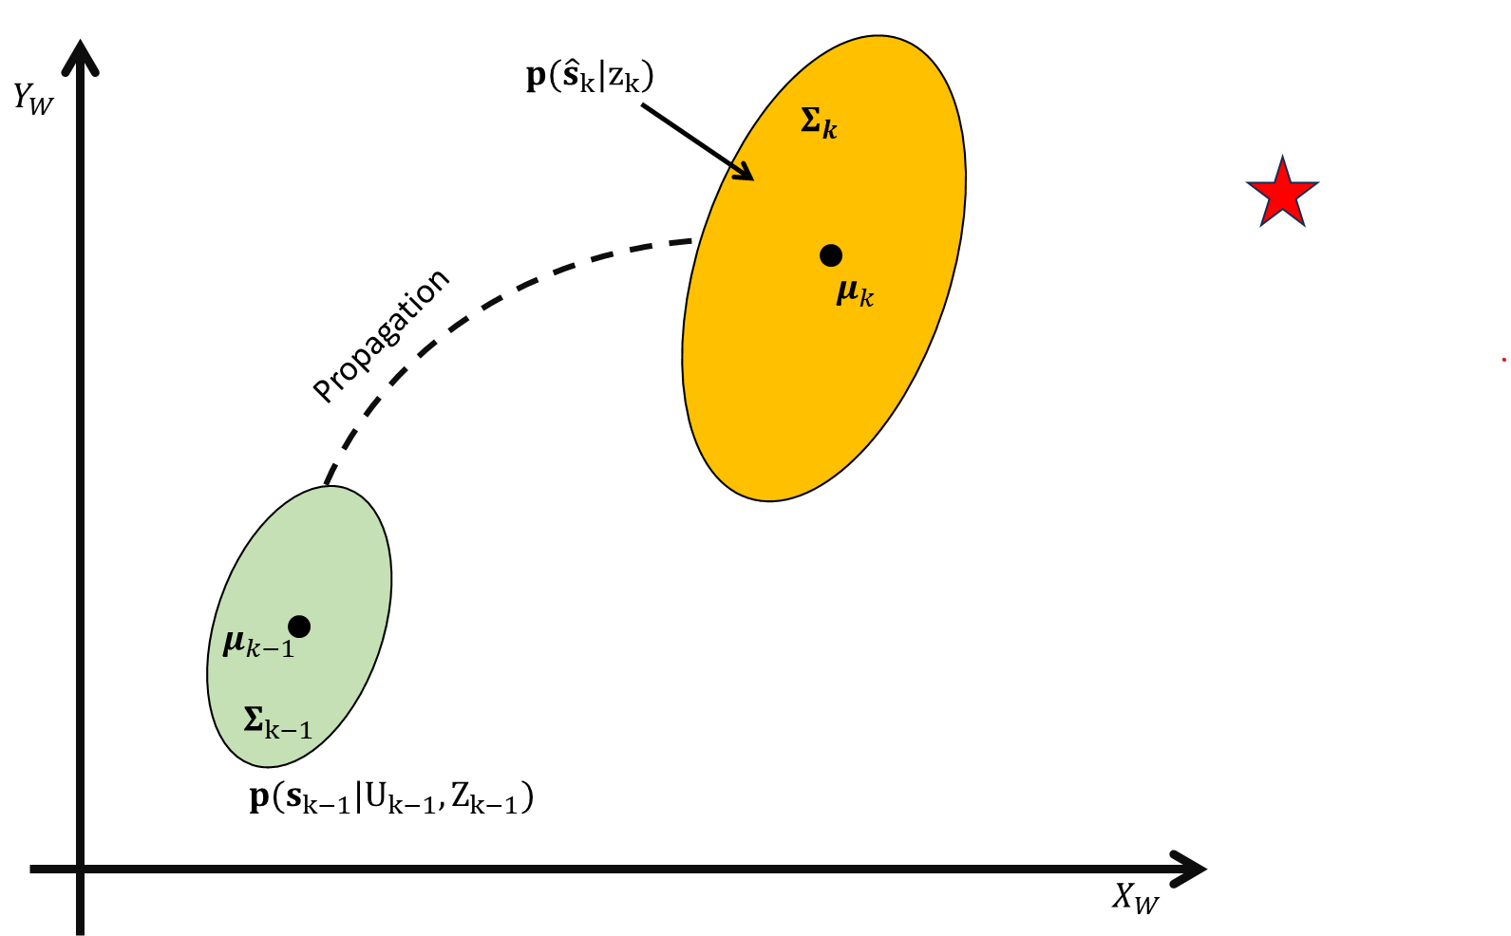

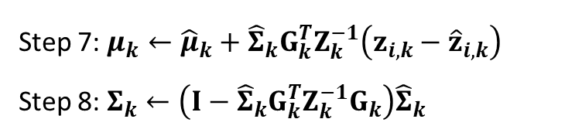


$$Correction:$$
Step 7: $μ_{k}←{\hat{μ}}_{k}+{\hat{Σ}}_{k}G_{k}^{T}Z_{k}^{−1}\left(z_{i,k}−{\hat{z}}_{i,k}\right)$
Step 8: $Σ_{k}←\left(I−{\hat{Σ}}_{k}G_{k}^{T}Z_{k}^{−1}G_{k}\right){\hat{Σ}}_{k}$
$$Notation:$$
$$K_{k}={\hat{Σ}}_{k}G_{k}^{T}Z_{k}^{−1}$$
$$K_{k} is the Kalman gain$$

Slide 32
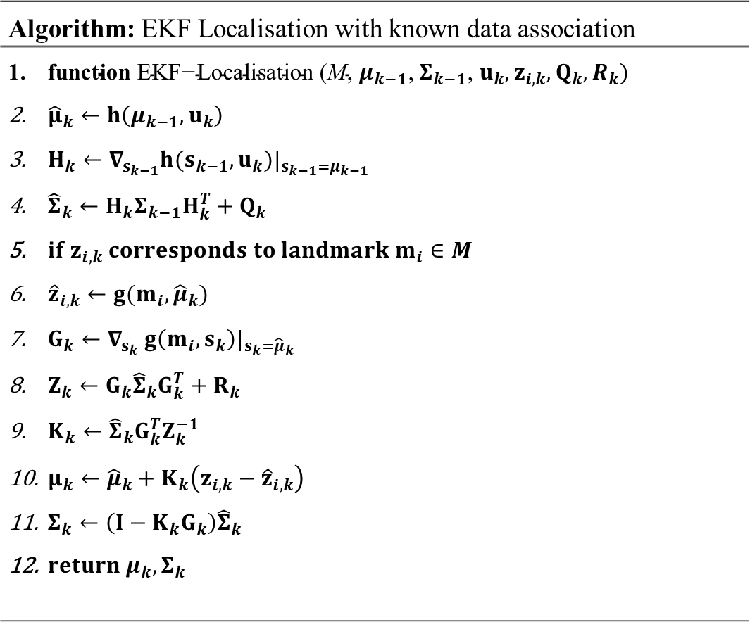
Kalman filter localisation
Algorithm: EKF Localisation with known data association
$\text{function} \text{EKF}\text{−}\text{Localisation}\text{ (}\text{M}\text{, }μ_{k−1}\text{, }Σ_{k−1}\text{, }u_{k}, z_{i,k}, Q_{k},R_{k})$ ${\hat{μ}}_{k}←h\left(μ_{k−1},u_{k}\right)$ $H_{k}←∇_{s_{k−1}}h(s_{k−1}, u_{k})|_{s_{k−1}=μ_{k−1}}$ ${\hat{Σ}}_{k}←H_{k}Σ_{k−1}H_{k}^{T}+Q_{k}$ $if z_{i,k} corresponds to landmark m_{i}∈M$ ${\hat{z}}_{i,k}←g(m_{i},{\hat{μ}}_{k})$ $G_{k}←∇_{s_{k}} g\left(m_{i},s_{k}\right)|_{s_{k}={\hat{μ}}_{k}}$ $Z_{k}←G_{k}{\hat{Σ}}_{k}G_{k}^{T}+R_{k}$ $K_{k}←{\hat{Σ}}_{k}G_{k}^{T}Z_{k}^{−1}$ $μ_{k}←{\hat{μ}}_{k}+K_{k}\left(z_{i,k}−{\hat{z}}_{i,k}\right)$ $Σ_{k}←\left(I−K_{k}G_{k}\right){\hat{Σ}}_{k}$ $return μ_{k},Σ_{k}$

Slide 33



Kalman filter
Particular cases:
$$K_{k}={\hat{Σ}}_{k}G^{T}{\left(G{\hat{Σ}}_{k}G^{T}+R_{k}\right)}^{−1}$$
$$R_{k}≅0$$
1. In the case of a perfect exteroceptive sensor, i.e., :
$$K_{k}={\hat{Σ}}_{k}G^{T}{\left(G{\hat{Σ}}_{k}G^{T}\right)}^{−1}={\hat{Σ}}_{k}G^{T}{\left(G^{T}\right)}^{−1}{\hat{Σ}}_{k}^{−1}G^{−1}=G^{−1}$$
$$μ_{k}={\hat{μ}}_{k}+G^{−1}\left(z_{k}−G{\hat{μ}}_{k}\right)$$
we trust only the exteroceptive sensor,
we don’t trust the prediction model at all.
$$μ_{k}=G^{−1}z_{k}$$

Slide 34




Kalman filter
Particular cases:
$$K_{k}={\hat{Σ}}_{k}G^{T}{\left(G{\hat{Σ}}_{k}G^{T}+R_{k}\right)}^{−1}$$
$$R_{k}$$
$$R_{k}=∞$$
2. In case of a bad sensor is very big, i.e., :
$$K_{k}={\hat{Σ}}_{k}G^{T}{\left(G{\hat{Σ}}_{k}G^{T}+R_{k}\right)}^{−1}={\hat{Σ}}_{k}G^{T}{\left(G{\hat{Σ}}_{k}G^{T}+∞\right)}^{−1}$$
$$K_{k}={\hat{Σ}}_{k}G^{T}{\left(∞\right)}^{−1}=0$$
we trust only the prediction model,
we don’t trust the exteroceptive sensor at all.
$$μ_{k}={\hat{μ}}_{k}$$
$$Σ_{k}=\left(I−K_{k}G_{k}\right){\hat{Σ}}_{k}={\hat{Σ}}_{k}$$

Slide 35
Kalman filter – 1-D example

